Slide 1





Institutional Economics
“if you think history and ideas matter,
institutions structure actors’ choice but are subject to change by actors themselves, and real people make decisions that are not always efficient or purely self-interested, then you are probably an institutionalist” (Steinmo 2008 p.136).
Dr Tim Thornton, Director, School of Political Economy
Senior Research Fellow, Economics in Context Initiative, Boston University
Senior Research Fellow, Global Development and Environment Institute, Tufts University

Slide 2
Institutions = Rules
Formal and informal rules of social and economic life
E.g. Legal system, norms, routines, conventions, traditions, etiquette.
Organisations are sets of institutions
Institutions constrain (but also enable) thoughts and actions.
Institutions often internalized within individuals via habits.
Institutions often quite stable but also evolve over time.
We make institutions (and habits), but they partly make us – ‘downward reconstitutive causation’

Slide 3


Shallow versus Deep Institutional Analysis

Slide 4
Shallow Analysis
Dominant approach in mainstream economics in regard to institutions
Focus on exchange via markets with little or no focus on related institutions (beyond property rights and legal contracts)
Seller accurately calculates benefits of exchange at a given price outweigh the cost for them.
Buyer accurately calculates that benefits of exchange outweigh the cost for them.
A voluntary, mutually beneficial market exchange is then understood to occur.
Most subsequent analysis is then largely confined to modelling how changes in prices (or to the income or participants) will change how much is then supplied and sold.

Slide 5
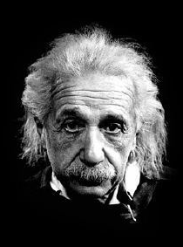
Shallow Analysis Generally Assumes
Preferences of all actors are given
Buyer and seller possess all the relevant information about the trade,
All actors can accurately weigh up the cost and benefits of buying/selling
Trade is voluntary so must be mutually beneficial
Complete legal contract specifies all aspects of the trade and can be drafted, signed and enforced at zero cost.
Implications:
Many economic and political problems vanish by starting with these assumptions. In particular, there is nothing for the exercise of power to be about.
No scope for conflict or coercion in any economic exchange.
Impossible to manipulate or influence somebody
No information asymmetries
Analysis very amendable to formal modelling and precise predictions. But premises are unrealistic, so why should such modelling (and its predictions) be taken all that seriously?
Techniques can get complex (and even intimidating) yet the underlying theory is ultimately always very, very simple.
Make your explanations as simple as possible but not simpler – Albert Einstein

Slide 6
Why start with Institutional Economics?
The economy is essentially made of institutions
Strong links to other schools
A social science approach to economics
Sometimes sounds like ‘common sense’ yet institutional insights are often absent in much economic analysis – and this can really matter.
A good way to explore methods, theory and methodology in all social science analysis.
Notes:
*“if you think history and ideas matter, institutions structure actors’ choice but are subject to change by actors themselves, and real people make decisions that are not always efficient or purely self-interested, then you are probably an institutionalist” (Steinmo 2008 p.136)

Slide 7

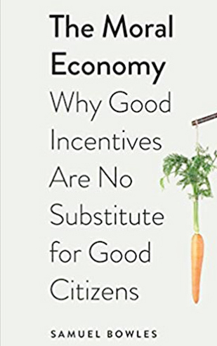

Institutions and Cooperation
Any social way of operating requires institutions
Breaching an institution usually carries some formal or informal sanction
Institutions are confining but also enabling – because they provide a degree of predictability and certainty
Informal institutions such norms are as important as the formal institutions

Slide 8
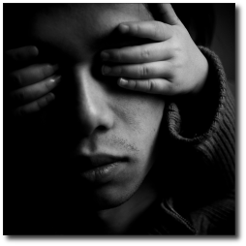
Institutional Blindness
Dangers in assuming necessary institutions already exist, will arise naturally or can be easily transplanted.
This blindness is often an enormous problem in mainstream economics.
Example of USSR Transition.
Neoliberalism simply as a ‘move towards the market’
Markets are institutions that need be to be nested inside other institutions

Slide 9
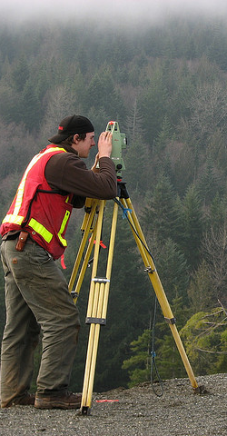
Key Focus Points of Institutional Economists
Search costs, bargaining costs & enforcement costs? (ala Coase and ‘Transaction Cost Economics’)
Non-market coordination within organisations (ala Nelson and Winter’s Evolutionary Theory of The Firm)
Where do preferences come from? (ala J K Galbraith)
The social nature of consumption (ala Thorstein Veblen)
Interaction between ‘social’ and ‘economic’ variables (ala Gunnar Myrdal)
Issues of power and politics in the economy (ala J K Galbraith)
Economic activity as being evolutionary in nature (Geoff Hodgson)

Slide 10

Institutions in Action
Buying a cup of coffee at your local café is normally understood as a ‘market exchange’ but yet many other institutions are involved:
Health regulations (state power)
Labour standards (state & social power)
Insurance (market & state power)
Money (state power)
Norms/etiquette (social power)
Economies, and most specific economic phenomena, involve the simultaneous presence of state, market and social power (Olin-Wright 2006)

Slide 11
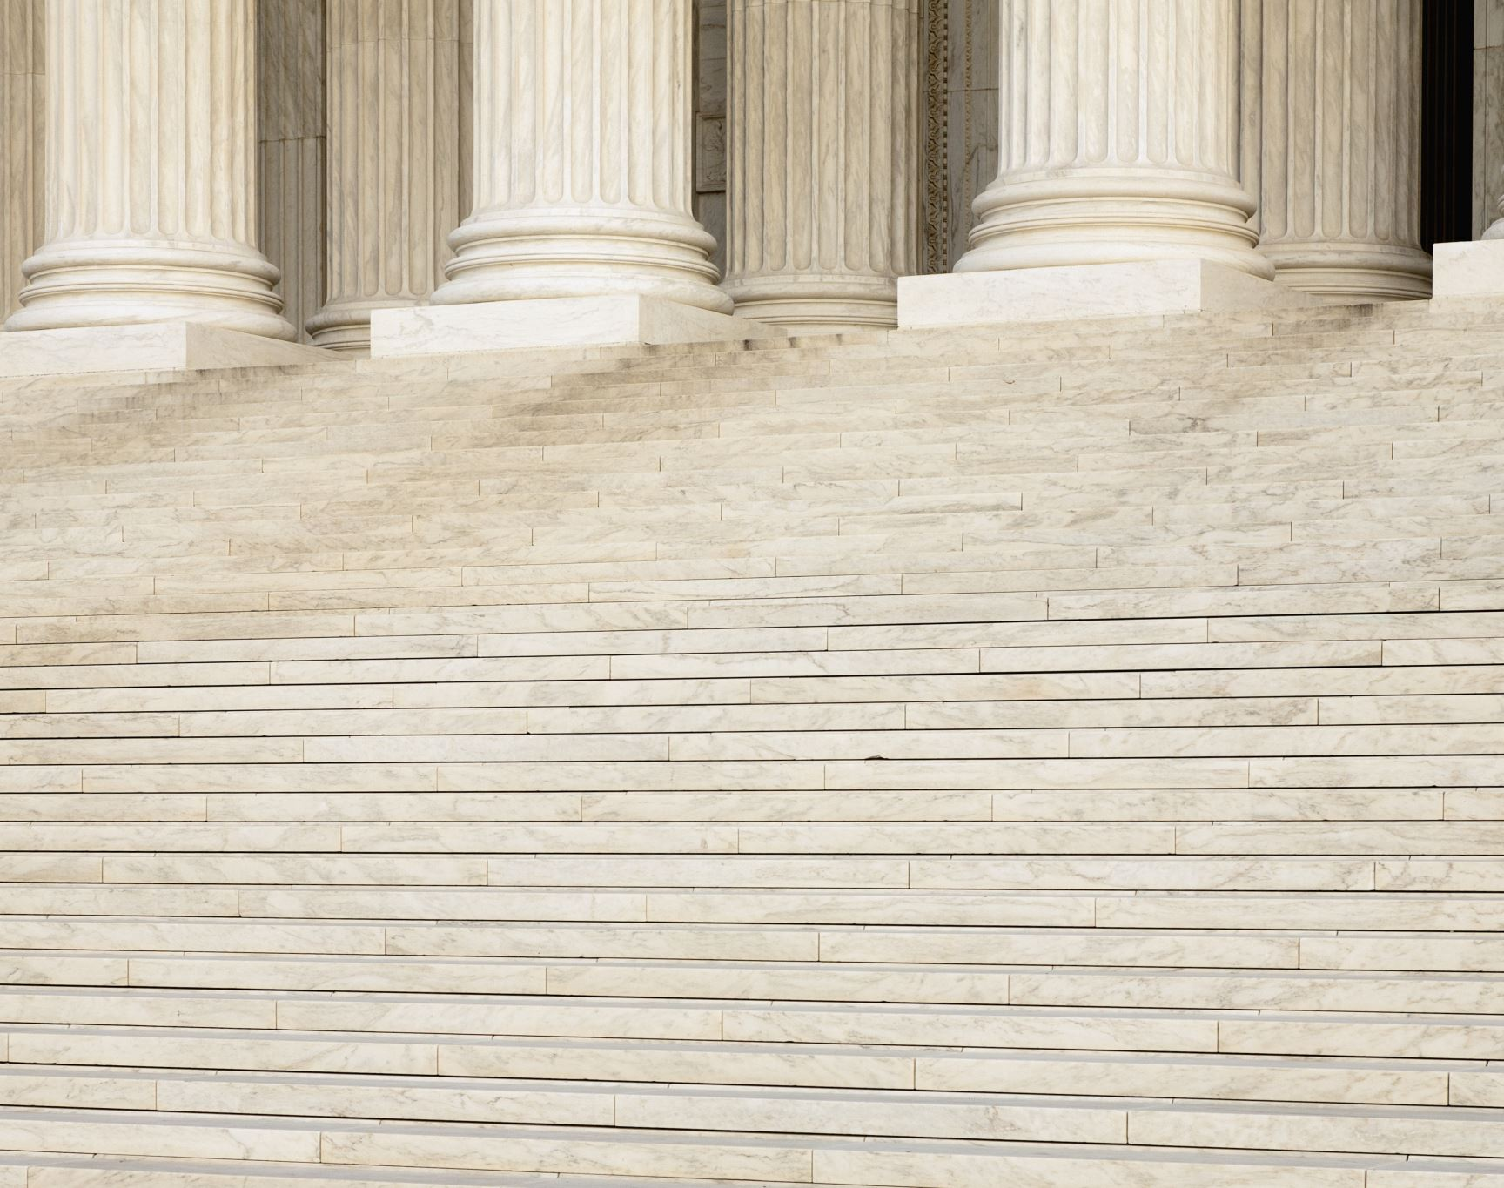
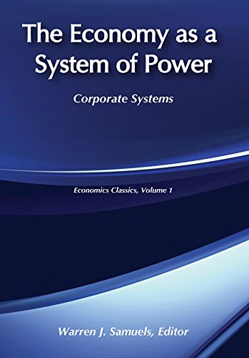
Economies (and societies) as systems of power
Economy made of institutions (rules)
Rules channel and reflect power
Therefore, economy is a system of power (not just a system of markets)
Changes to institutions will often upset the ‘institutional truce’ – the balance of power
Institutional changes will often be channeled down existing dykes of self-interest.
Most bad situations/institutions are good for somebody (Joan Robinson)

Slide 12

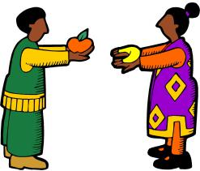
Institutionalist take on markets (1)
Recap: in economics textbooks markets usually float in abstract/platonic space without reference to other institutions, but studying markets without reference to institutions is like studying the movement of blood without reference to the body (Coase 1984)
The market is “political device to achieve certain outcomes, conferring relative benefits on some and costs on others in both political and economic terms; it is, in essence, a political institution that plays a crucial role in structuring society and international politics” (Underhill 1994 p.19).

Slide 13

Institutionalist take on markets (2)
Some socialists, see markets as inherently tied to capitalism and thus inherently problematic
Institutionalist take is not so much - yes or no’, or markets – for or against, but markets - when and how?’
Considerable focus on getting the institutions around markets to work for the social benefit.
No fixed answer: Technological and social facts on the ground always need to be taken into account - context always matters
Key questions are whether you are able to put the supporting institutions in place and whether they can be maintained (or adapted) over time in order to promote the social, economic and environmental good.
Not also that a pro-market position is not necessarily capitalist given theoretical and real-world systems of market socialism.
All economies are hybrids of social governance, state governance and market governance

Slide 14

The State and Planning
“In a properly designed system, planning and markets do not contradict each other”.
“They are not mutually exclusive. Rather, the choice of one or another for any particular problem is a matter of what works best for the purpose at hand”.
“Planning, properly conceived, deals with the use of today’s resources to meet tomorrow’s needs. It specifically tackles issues markets cannot solve”.
“A country that does not have a public planning system simply turns that function over to a network of private enterprise—domestic or foreign—which then becomes the true seat of economic power. And that is why the struggle over planning is, and remains, such a sensitive issue: it is a struggle over power” (James Galbraith 2009).

Slide 15

Elinor Ostrom: Beyond Markets and States
The government is supposed to have the responsibility, the will and the power to restructure society in whatever way maximizes social welfare….Private individuals, in contrast, are credited with little or no ability to solve collective problems among themselves. this makes for a distorted view of some important economic and political issues (Sugden cited by Ostrom 2009 p.417 emphasis added).
Some collective problems can and should be managed mainly at the local level mainly via informal institutions
See for example ‘Who Should Govern Nature’ https://www.youtube.com/watch?v=vT99LqJaTeI&t=120s
Elinor Ostrom: Institutional Political Economist

Slide 16


Approach to analysis
Methods are both qualitative and quantitative
Idiographic rather than nomothetic - context really matters
Rejection ahistorical, asocial, aspatial analysis
Epistemology is more empirical than rationalist in nature.

Slide 17


Agency versus Structure
Structure = existing institutions of society significantly determine much behaviour
Agency = our own choices and actions determine behaviour, and also institutional structure
Which should given priority in social explanation?
Different schools of thought and different ideologies differ on this question.
What is the relationship between the two types of causation?
agency
Structure

Slide 18


Methodological Interactionism
In institutionalism structure and agency co-determine one another. As a consequence:
History becomes important
Context becomes important
Rejection of methodological individualism (where rejects any downward reconstitutive causation from society to individual)
Rejection of methodological collectivism (where individuals actions and thoughts are totally determined by society)

Slide 19
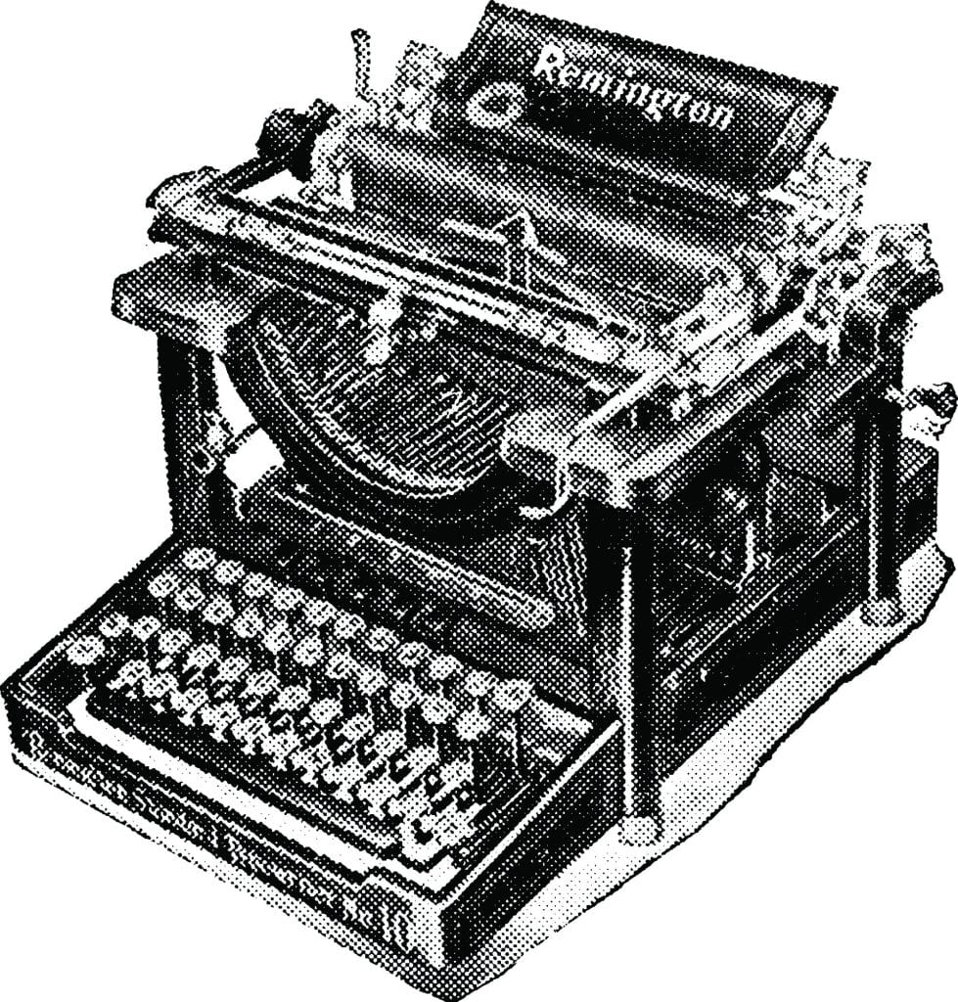
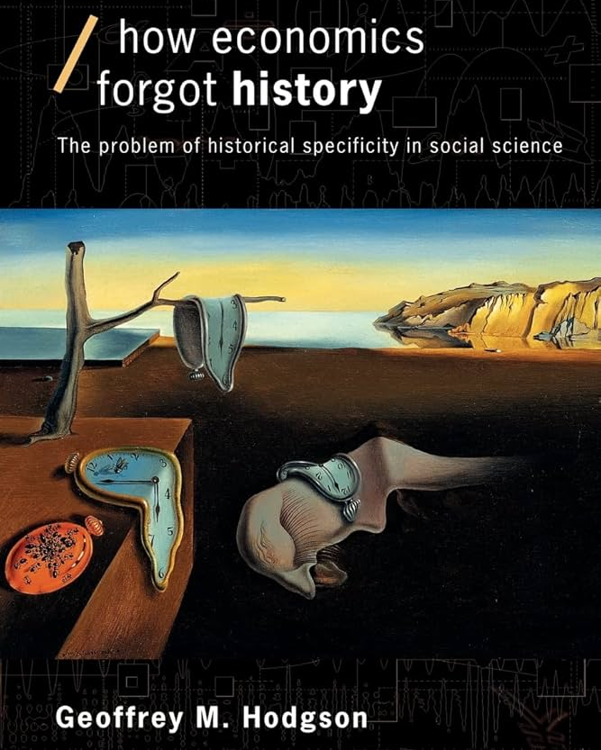
Importance of History and Context
Historical Lock-In (Path Dependence/Hysteresis)
Importance of Context – rejection of idiographic view of economics: ‘spread the truth, the laws of economics are like the laws of engineering, one set of laws works everywhere’ (Larry Summers)
Institutionalists long-standing focus on importance of history and context is in sync with (but broader than) recent critiques from those seeking to ‘decolonize economics’

Slide 20
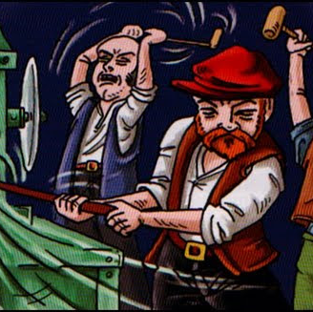
Technology and Institutions
Many institutions characterised by inertia.
Technological progress is usually more dynamic
This creates tension that often leads to creation of new or modified institutions
Tension can be peaceful or conflictual, gradual or revolutionary
Q. how will the technology of renewable energy impact current institutions?
Q. How to current institutions impact on the technology of renewable energy?

Slide 21

Circular and Cumulative Causation (CCC)
Alternative framework to the equilibrium approach.
Consistent with an evolutionary framework
Assumes instability and increasing returns
Change, calls forward supporting changes in direction of the initial change.
E.g. Change in A prompts a change in B which then prompts an even larger disturbance to A and so on: increasing returns
Can involve (and draw in) many variables
Snowball rolling down a hill, gathering in size and speed at an increasing rate.

Slide 22
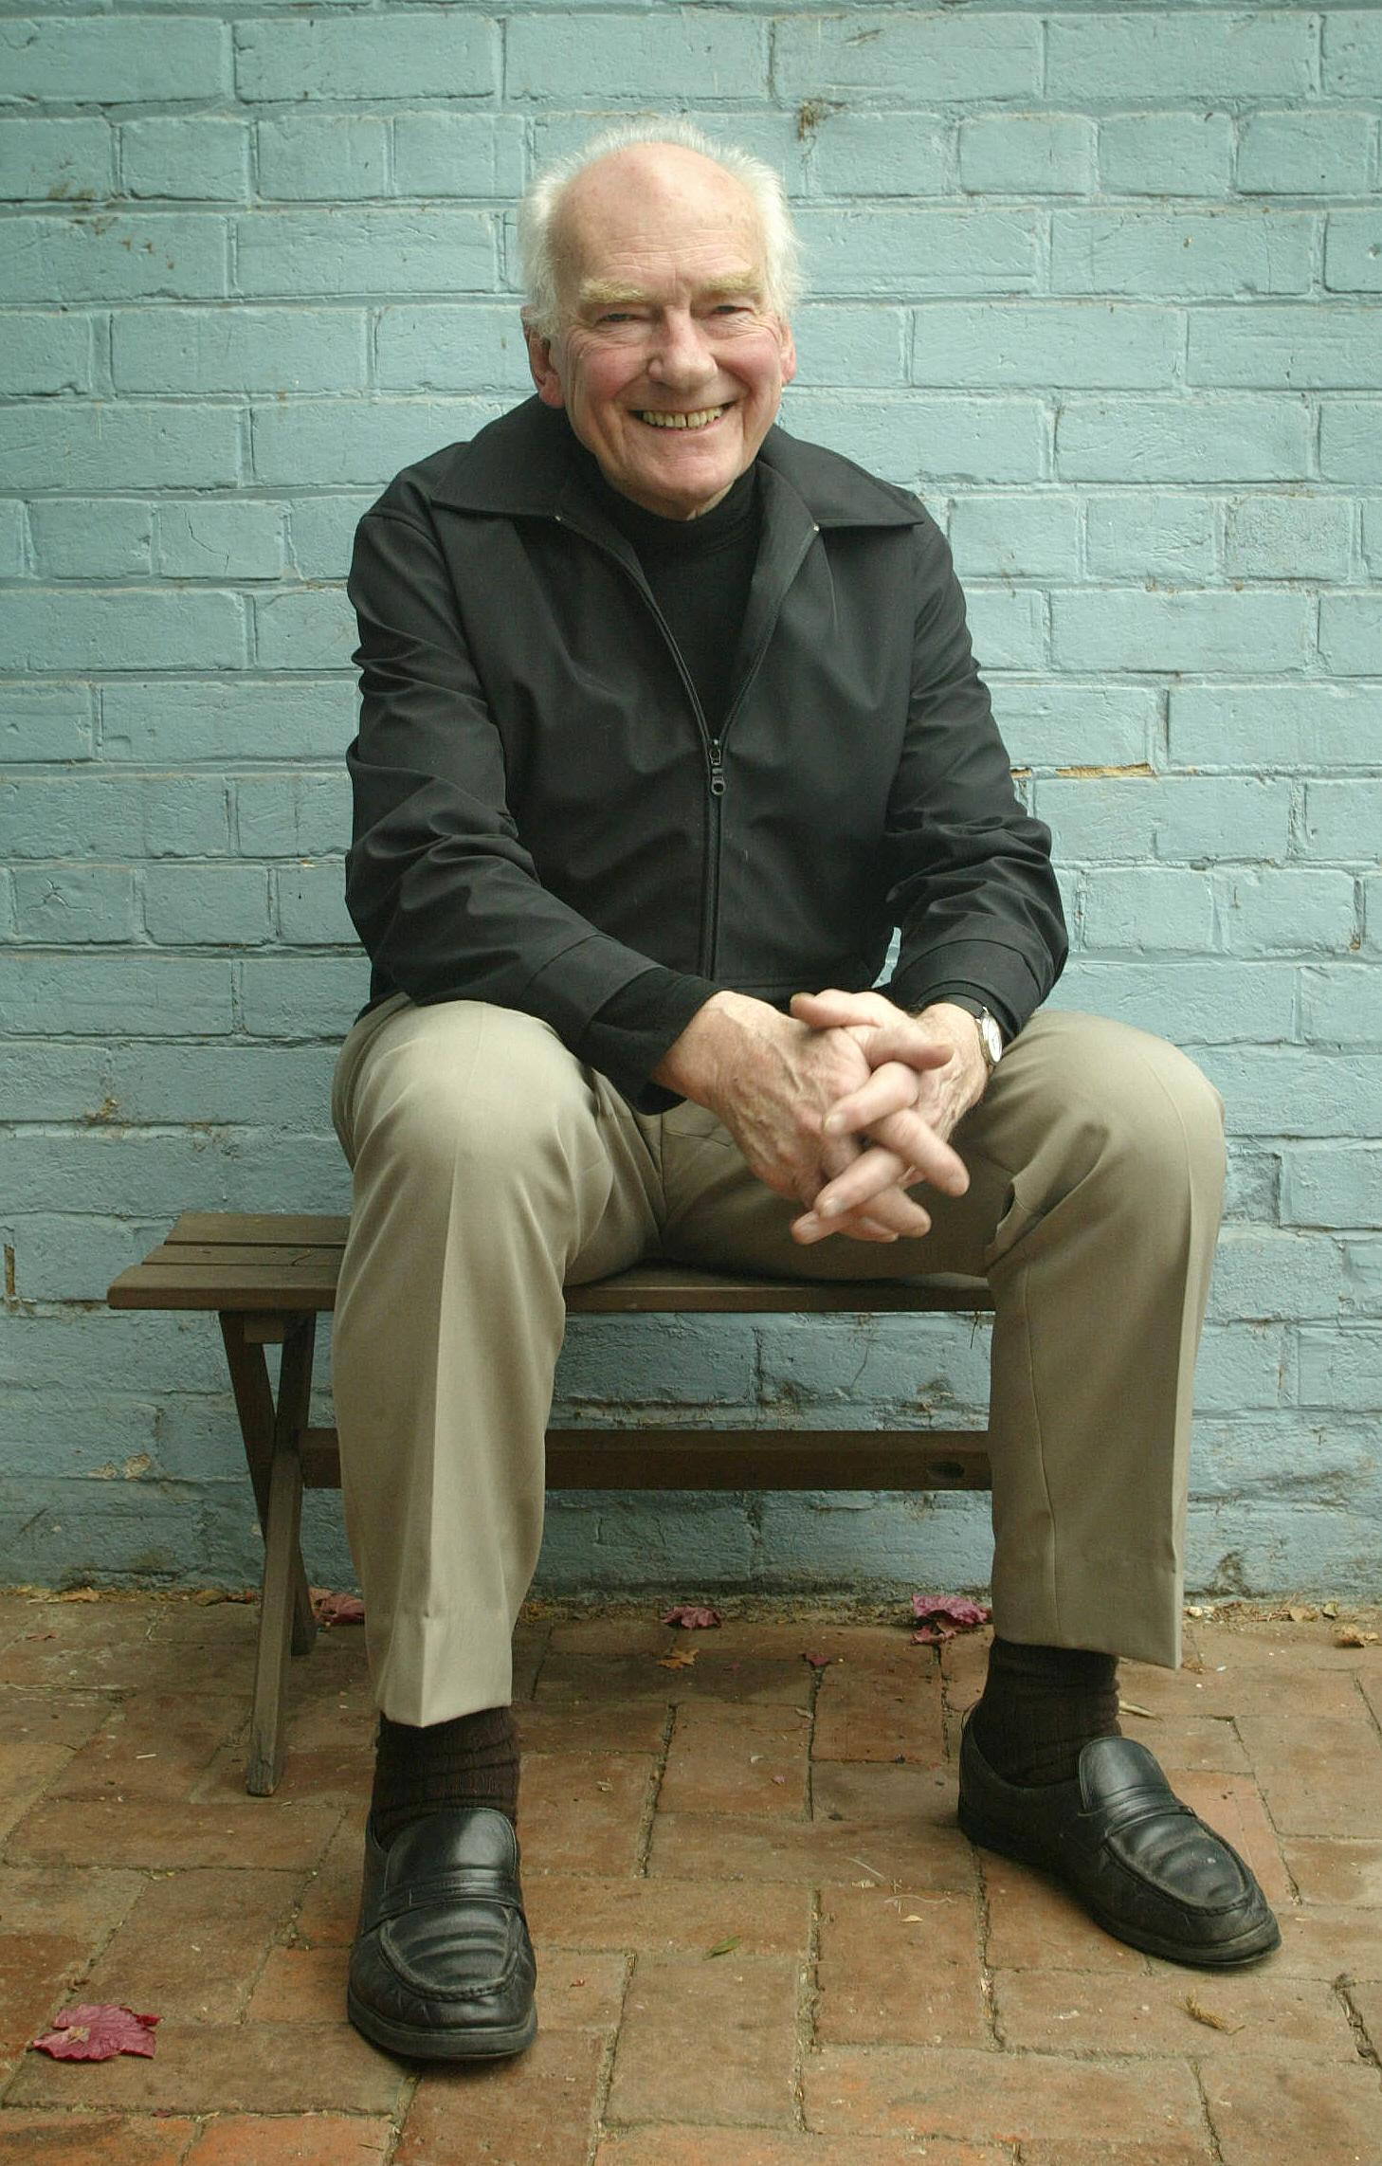
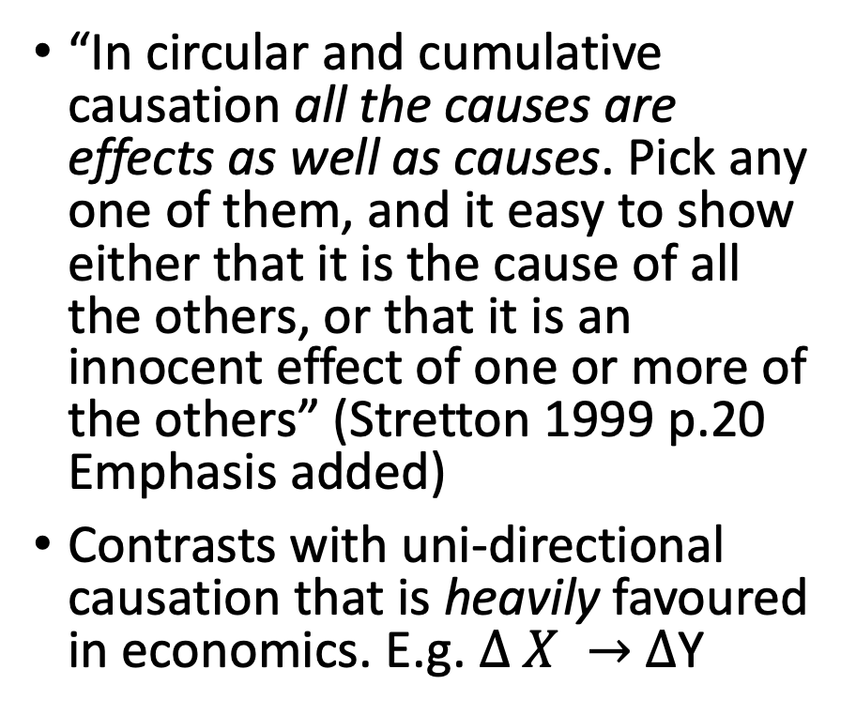
Circular and Cumulative Causation
“In circular and cumulative causation all the causes are effects as well as causes. Pick any one of them, and it easy to show either that it is the cause of all the others, or that it is an innocent effect of one or more of the others” (Stretton 1999 p.20 Emphasis added)
Contrasts with uni-directional causation that is heavily favoured in economics. E.g. $∆ X →$ $∆$Y
Hugh Stretton: Institutional Economist

Slide 23
Circular and Cumulative Causation: Example 2. Inflation
Workers demand more wages
Banks create more money
Producers raise prices
Price index measures changes
Middle economist: Break it here
Politician: Break it here.
Conservative economist: Break it here.
Radical economist: Break it here.

Slide 24
Circular and Cumulative Causation: Racism
A group is subject to discrimination (for whatever reason)
They are then consigned to systematically inferior economic and social circumstances
This usually results in lower incomes and higher unemployment.
These circumstances cause the victims of discrimination to cluster in areas where housing is cheaper, to wear cheaper clothing, and perhaps also to adopt self-destructive or antisocial patterns of personal behaviour.
That provides a basis and apparent justification for further discrimination against them

Slide 25
Circular and Cumulative Causation. Example 1
Specialisation reduces production costs
Lower costs spur growth of the market

Slide 26
Circular and Cumulative Causation: Regional Inequality
Particular cities and regions (for whatever historical or geographical reasons) forge ahead of others.
Their better-developed infrastructure attracts to most of the flows of capital and labour, further accentuating the core regions’ growth.
Meanwhile, emigration from the peripheral regions causes them to lose their younger and more entrepreneurial people and capital flows
Firms in the core regions, having the best access to consumer markets and factors of production, develop economies of scale, and external economies arise as firms cluster in those localities and thus pull ahead further.

Slide 27
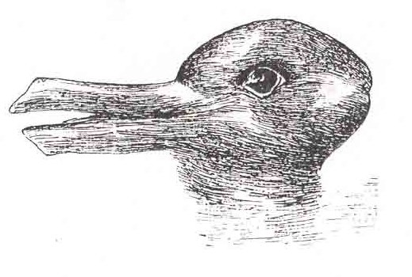
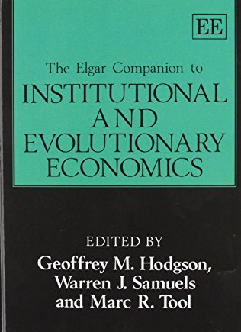
Evolution and institutions
Any school of thought needs some sort of theoretical engine.
Theory – or at least prior mental constructs – are always prior to any observation or analysis.
Institutionalism can (and should) be built up on Darwinian evolution theory
Darwinian evolution = variety, retention, selection
Sounds very simple, but yet it is often misunderstood as an optimising, teleological process which is quite the problem.
Evolutionary theory can cope well with history, context, learning, adaptation all of which institutionalists usually see as very important
Key contemporary person on evolution and institutions is Geoffrey Hodgson, though starts all the way back with Veblen
A good place to start further reading on evolution and economics

Slide 28

Relationship with other schools
Post Keynesian Economics and Institutionalism are considered by some as being one and the same school, PKE simply being more focused on macroeconomics.
Left flank of institutionalism articulates with Radical Political Economy and Marxism (see for example Phil O’Hara 2000)
Institutionalists can be considered the first behavioural economists via their rejection of perfectly rationality, given preferences, and following habits and rules.
Good links with all the other schools, partly because the economy is ultimately made of institutions
Links to neoclassical economics via the early work in ‘new’ institutional economics that assumed given individuals, full rationality etc), but links between the ‘new’ and ‘old’ (original) institutional economics have become less clear.

Slide 29

This Week’s Readings
Reading 1. Stretton on Institutionalism
Then choose from either
James Galbraith on the Need for Planning
Argyrous on Circular and Cumulative Causation
Stilwell on Institutional Economics

Slide 30

Summary: Institutional Economics
Institutions are the formal and informal rules that are the largely make up economic and social system.
Institutions often internalised as habits, so habits are significant.
A market is an institution that depends on a lot other institutions to operate effectively.
Economy is a system of power not just a system of markets.
Evolution provides institutionalisms theoretical engine
Institutions shape what we do, but also who we are.
Methodological interactionism is central.
Importance of history and context.
Importance of the state regulation and planning but also institutions to allow cooperation at the local level.

Slide 31

References
Coase, R. H. (1984). "The New Institutional Economics." Journal of Institutional and Theoretical Economics 140(1): 229-231.
Galbraith, James (2009) The Predator State: How Conservatives Abandoned the Free Market and Why Liberals Should Too. Simon and Shuster, New York.
O'Hara, P. A. (2000). Marx, Veblen, and contemporary institutional political economy : principles and unstable dynamics of capitalism. Cheltenham, Edward Elgar.
Steinmo, S. (2008). Historical Institutionalism Approaches and methodologies in the social sciences: a pluralist perspective. D. Della Porta and M. Keating. Cambridge, UK, Cambridge University Press: 118-138.
Sloan Wilson, D. (2016). "The Woman Who Save Economics From Disaster: Who is Elinor Ostrom." from evonomics.com/the-woman-who-saved-economics-from-disaster.
Underhill, G R D 1994, 'Conceptualizing the Changing Global Order', in G R D Underhill & R Stubbs (eds), Political Economy and the Changing Global Order, Macmillan, London.
Wall, D. (2017). Elinor Ostrom's rules for radicals : cooperative alternatives beyond markets and states. London, Pluto Press.
$$∆$$

