Slide 1

An Introduction to Political Economy and Economics Presentation 1A - A Brief Overview of Political Economy and SPE.

Slide 2

Structure of Presentation
What is the economy?
What is political economy (PE)?
PE’s relationship to economics
About the School of Political Economy

Slide 3

What is the economy?
A subsystem of the social system (society) that deals with the production and distribution of goods and services
Goods = tangible things you can drop on your toe
Services = intangible things like advice, expertise, care etc.

Slide 4
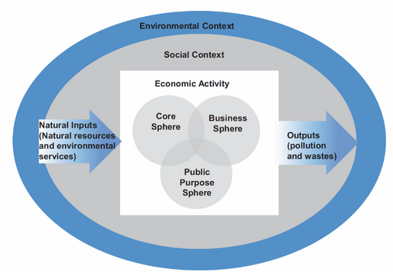
What is the economy? (continued)
Core sphere – households, families and communities (approx. 25%)
Public purpose sphere – government, international institutions, non-profits (approx. 25%)
Business sphere – private, for-profit firms (approx 50%)

Slide 5
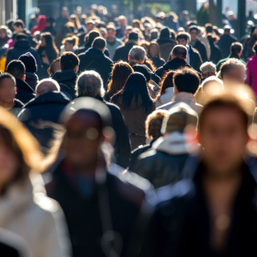
What is the economy? (continued)
Economy utilises physical things like equipment, infrastructure, natural resources.
However, it is ultimately best understood as being a set of institutions
Institutions = formal and informal rules
Organisations = networks of institutions
We make the rules, but the rules also make us, not only shaping what we do but who are.

Slide 6

Markets and the Economy
A market is a place where there is an exchange of a good or service for money, or for some other good or service (barter)
Can reference to a particular place or online, can be specific and concrete or more general and abstract.
Economy often understood to be just a system of markets, but markets are just one type of institution component of an economy
Studying markets without reference to other institutions is ‘like studying the movement of blood without reference to the body’ - Ronald Coase.

Slide 7

What is Political Economy?
The study of the social provisioning process in order to promote human wellbeing and ecological balance.
In practice, this means the focus is on:
What goods and services are produced?
How are they produced
For whom are they produced?
How are resources sustained?
The pluralist and interdisciplinary approach to studying economic phenomena

Slide 8
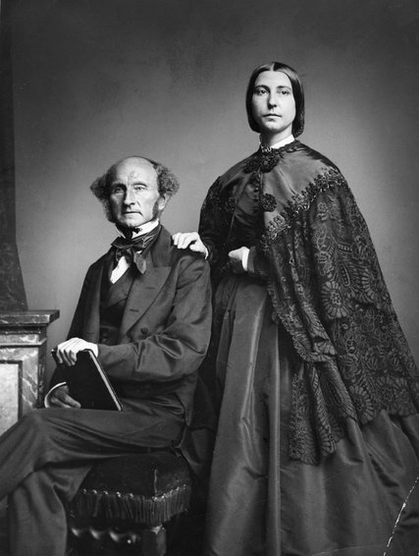
Pluralist Political Economy
“He [they] who knows only his own side of the case knows little of that. His [their] reasons may be good, and no one may have been able to refute them. But if he [they] is [are] equally unable to refute the reasons on the opposite side, if he [they] does not so much as know what they are, he [they] has no ground for preferring either opinion” John Stuart Mill
Ha-Joon Chang Video ‘Economics is for Everybody’
John Stuart Mill and Harriet Taylor Mill

Slide 9

Interdisciplinarity
Desirability of co-informing dialogue with other disciplines
Answer to most economic problems is a political question
Ethical, epistemological and ontological dimensions of economic analysis give it a strong philosophical dimension.
If you are studying other disciplines, political economy is probably relevant and helpful

Slide 10
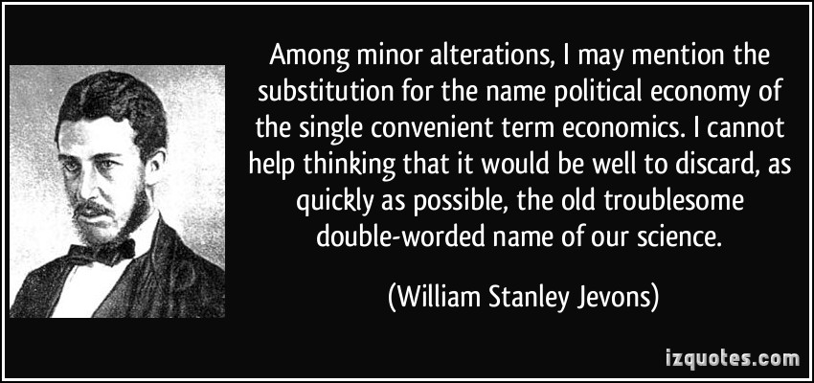
Political Economy (PE) versus Economics
Political Economy was the original name for economics and the original approach was pluralist and interdisciplinary
A less pluralist and interdisciplinary approach to study the economy emerged in the 1870s that is known ‘economics’
A broad conception of PE adopted here that subsumes economics as of it constituent schools.

Slide 11
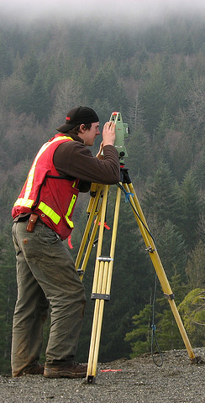
Key Schools In Political Economy
Institutional Economics
Behavioural Economics
Austrian Economics
Neoclassical (Mainstream) Economics
Post Keynesian Economics
Radical Political Economy
Georgist Political Economy
Feminist Economics
Ecological Economics
“In every country, educated institutions in general, and universities in particular, are supported directly or indirectly by the established authorities
and whether in Chicago or in Moscow, their first duty is to save their pupils from contact with dangerous thoughts”. (Robinson 1980 p.98)

Slide 12
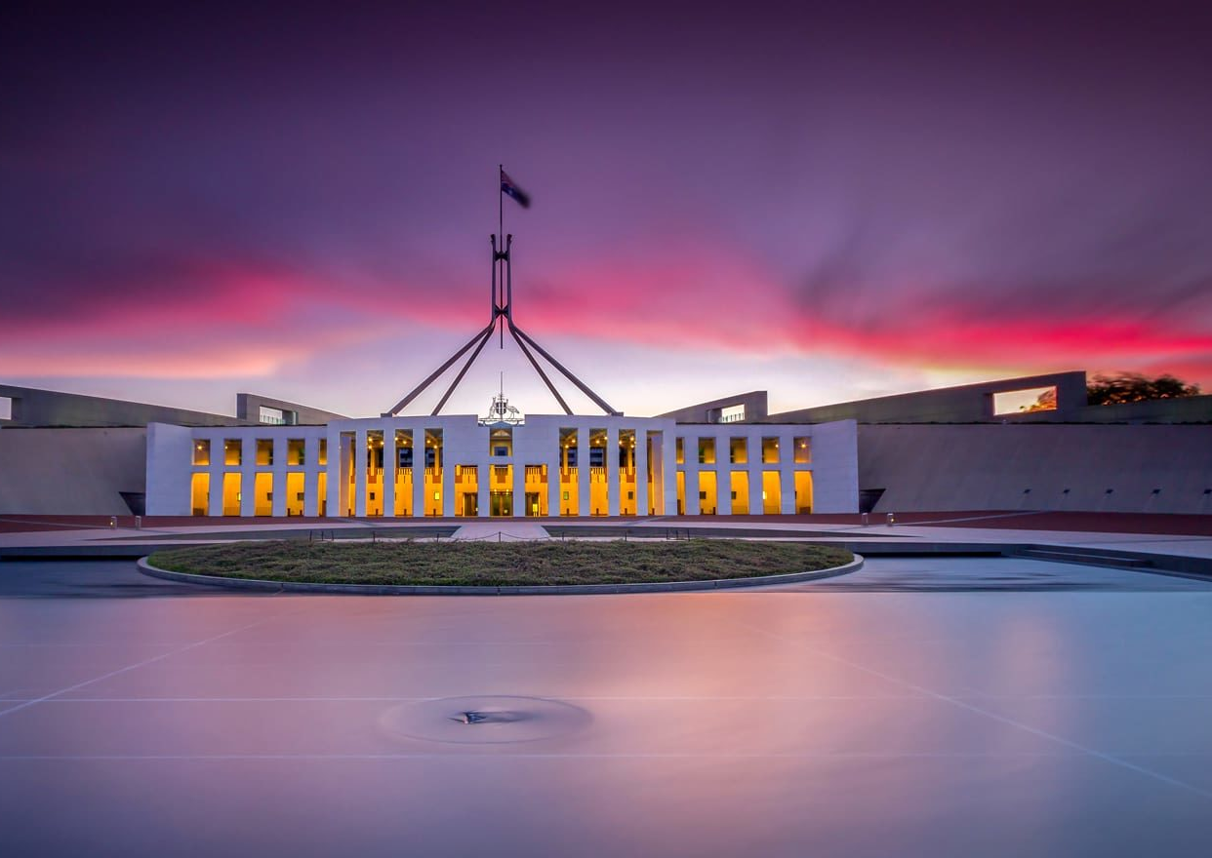
The Importance of PE
Its rare the people have any real knowledge of political economy.
But if offers insights into social and economic processes are profound.
PE can help you to understand and thus critically assess ‘conventional wisdoms’ and to develop alternative views
“The Importance of studying economics is not to acquire a set of ready-made answers but to avoid being deceived by other economists” – Joan Robinson
A higher level of critical economic literacy makes for a more a democratic society.
Pic: Australian Parliament House

Slide 13

PE seeks to explain and rectify
Economic booms, busts, stagnation
Poverty and underdevelopment
Unemployment, inflation and deflation
Inequality
Environmental degradation
Discrimination and injustice

Slide 14

Rationale for School of Political Economy
Belief that it was possible to deliver tertiary-level education at a higher standard and at lower cost than usually occurs within an increasingly problematic university system.
University economics education has become overly narrow and that reform strategies needed to go beyond just trying to change minds inside the economic mainstream.
SPE Established in 2019. Has since taught about 1500 students.

Slide 15
Educational Approach/Philosophy
Self-assessment, combined with support, including individual support as required.
Subject can be engaged with at differing levels of depth.
Choose the level that suits your needs, interests and available time.
Safe space for all.

Slide 16

How this subject is taught
Emphasis on conceptual frameworks, starting points and foundational assumptions. Why?
Starting ideas and assumptions shape and constrain the conclusions.
Different starting points lead to different end points.
All roads do not lead to Rome!
What you see can be heavily determined by how you decide to look
Aim for Parity of Treatment

Slide 17

Run of events
Weekly lecture (approx. 1 hour) and two set readings (video or audio)
Questions posted in advance for you to think about and (perhaps) formulate responses to.
Group discussion of lectures and readings and set discussion questions
Some suggested (optional) further reading for the keen
Responses to set discussion questions posted after each tutorial.

Slide 18
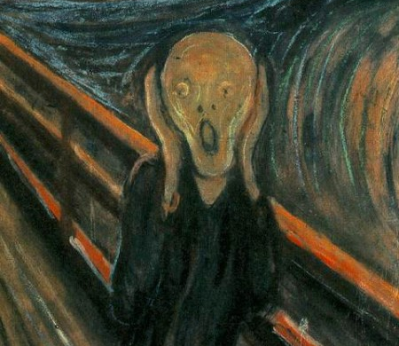
Asking for help
If you are confused, ask for help, either:
In-class
via email
via phone
via zoom
All questions are good!
Student in completely unnecessary distress

