Slide 1
SPE101 An Introduction to Political Economy and Economics
Overview Lecture

Slide 2
What is political economy?
A plural and interdisciplinary way of studying economic phenomena
PE was the original name for economics and the original approach was pluralist and interdisciplinary
The term political economy is used to demarcate it from the far less pluralist and interdisciplinary approach to economics ofte taken under the label of ‘economics’

Slide 3
An Expanded Definition of Political Economy
The study of the social provisioning process in order to promote human wellbeing and ecological balance.
In practice, this means the focus is on:
What goods and services are produced?
How are they produced
For whom are they produced?
How are resources sustained?
The pluralist and interdisciplinary approach to studying economic phenomena that is adopted here is currently distinctive enough to justify it being differentiated from ‘economics’

Slide 4
Rationale for School of Political Economy
Belief that it was possible to deliver tertiary-level education at a higher standard and at lower cost than usually occurs within an increasingly problematic university system.
University economics education has become overly narrow and that reform strategies needed to go beyond just trying to change minds inside the economic mainstream.

Slide 5
Educational Approach/Philosophy
Self-assessment, combined with support, including individual support as required.
Subject can be engaged with at differing levels of depth.
Choose the level that suits your needs, interests and available time.
Safe space for all.

Slide 6
The Schools We Will Be Examining
Institutional Economics
Behavioural Economics
Austrian Economics
Neoclassical Economics
Post Keynesian Economics
Radical Political Economy
Georgist Political Economy
Feminist Economics
Ecological Economics
“In every country, educated institutions in general, and universities in particular, are supported directly or indirectly by the established authorities
and whether in Chicago or in Moscow, their first duty is to save their pupils from contact with dangerous thoughts”. (Robinson 1980 p.98)

Slide 7
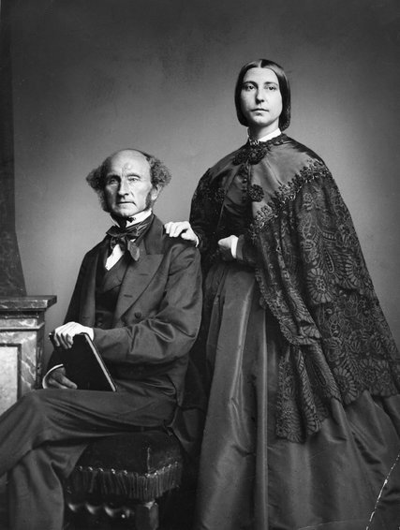
Pluralist Political Economy
“He [they] who knows only his own side of the case knows little of that. His [their] reasons may be good, and no one may have been able to refute them. But if he [they] is [are] equally unable to refute the reasons on the opposite side, if he [they] does not so much as know what they are, he [they] has no ground for preferring either opinion” John Stuart Mill
Ha-Joon Chang Video ‘Economics is for Everybody’
John Stuart Mill and Harriet Taylor Mill

Slide 8
Interdisciplinarity
Desirability of co-informing dialogue with other disciplines
Answer to most economic problems is a political question
Ethical, epistemological and ontological dimensions of economic analysis give it a strong philosophical dimension.
If you are studying other disciplines, political economy is probably relevant and helpful

Slide 9
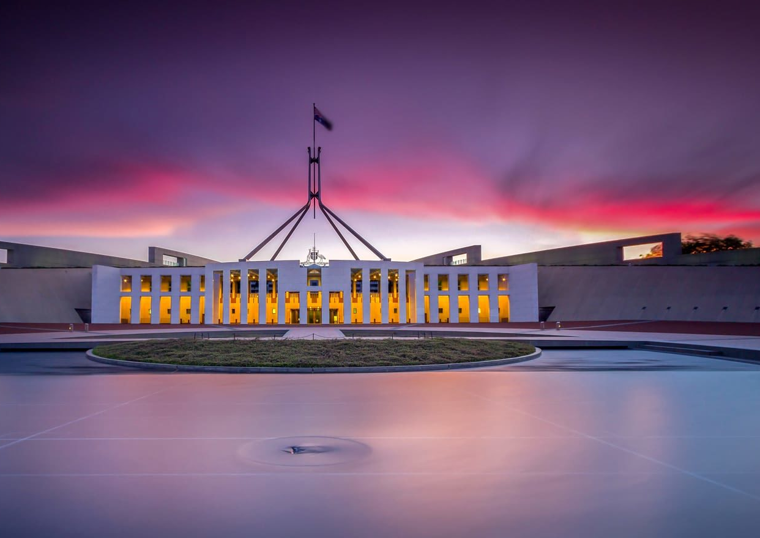
The Importance of PE
Its rare the people have any real knowledge of political economy.
But if offers insights into social and economic processes are profound.
PE can help you to understand and thus critically assess ‘conventional wisdoms’ and to develop alternative views
The Importance of studying economics is not to acquire a set of ready-made answers but to avoid being deceived by other economists – Joan Robinson
A higher level of critical economic literacy makes for a more a democratic society.

Slide 10
PE seeks to explain and rectify
Economic booms, busts, stagnation
Poverty and underdevelopment
Unemployment, inflation and deflation
Inequality
Environmental degradation
Discrimination and injustice

Slide 11
How we will investigate each school
Emphasis on conceptual frameworks, starting points and foundational assumptions. Why?
Starting ideas and assumptions shape and constrain the conclusions.
Different starting points lead to different end points.
All roads do not lead to Rome!
What you see can be heavily determined by how you decide to look
Aim for Parity of Treatment

Slide 12
Run of events
Weekly lecture (approx. 1 hour) and two set readings (video or audio)
Questions posted in advance for you to think about and (perhaps) formulate responses to.
Group discussion of lectures and readings and set discussion questions
Some suggested (optional) further reading for the keen
My responses to set discussion questions posted after each tutorial.

Slide 13
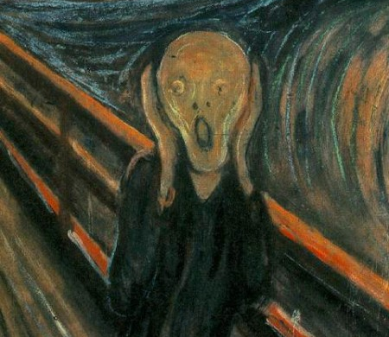
Asking for help
If you are confused, ask for help, either:
In-class
via email
via phone
via zoom
All questions are good!
Student in completely unnecessary distress

Slide 14
References
Mill, JS 1859, On Liberty, John Parker and Son, London.
Robinson, Joan (1980) Collected Economic Papers MIT Press, Cambridge MA
Robinson, Joan (1981) What Are the Questions? And Other Essays: Further Contributions to Modern Economics M. E. Sharpe, Armonk.

