Slide 1
Institutional Economics
SPE101. An Introduction to Political Economy and Economics

Slide 2
Why start with Institutonalism
Strong links with other schools of political economy.
Economics as social science
“if you think history and ideas matter, institutions structure actors’ choice but are subject to change by actors themselves, and real people make decisions that are not always efficient or purely self-interested, then you are probably an institutionalist” (Steinmo 2008 p.136)
Sometimes sounds like ‘common sense’ yet the central ideas are often ignored in mainstream economomics
Excellent means to think more generally about methods, theory and methodology in the social sciences.

Slide 3
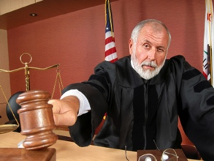
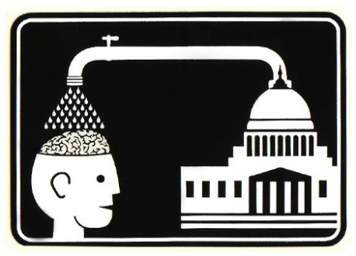
Institutions = Rules
Formal and informal rules of social and economic life (laws, norms, routines, conventions, traditions, etiquette, etc).
Our activity is always embedded in institutions
Oganisations are largely composed of institutions (i.e. formal and informal rules)
Institutions constrain but also enable thoughts and actions.
Significantly, we often internalise institutions via mental and physical habits in a way we are only semi-conscious of.
Durable but still subject to change.
We make institutions (and habits), but to a significant extent they make us.

Slide 4
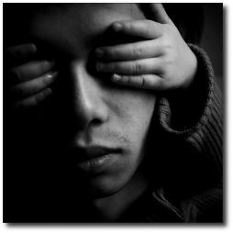
Institutional Blindness
Dangers in assuming necessary institutions exist or will arise naturally (economists often guilty of this).
Example of USSR Transition.
We may also under-rate role of path-dependence and lock-in
Markets are institutions that need be to be nested inside other institutions

Slide 5
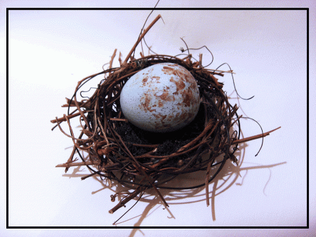
Identifying Institutions in Action
Purchase of a cup of coffee at your local café
Is it simply just a market transaction? No! What about:
Health regulations
Labour standards
Insurance
Money
Language
Informal institutions such as norms/etiquette
Q. Think of another ‘market’ exchange and identify what supporting institutions are required.

Slide 6
Institutions in Detail (1)
Any social way of doing things depends on institutions
Breaching an institution usually carries some formal or informal sanction
Informal institutions as important as the formal institutions

Slide 7
Institutions in detail (2)
Social constructs – made by humans
Mental constructs – not physical ones
Always potentially contested by interest groups – formation and change of institutions involve winners and losers.
Most bad situations/institutions are good for somebody
Forming and changing institutions involves power of some kind.
So, if the economy made of institutions, the economy is a system of power

Slide 8
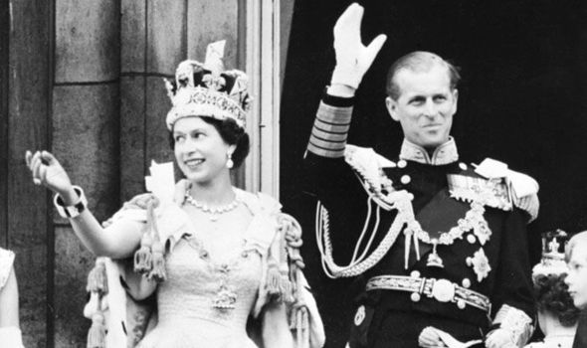
Institutions in detail (3)
Instrumental institutions: enabling for individuals, society and for the social provisioning process
Ceremonial institutions: perpetuating of rank and privilege for the few at the expense of the many
Is this a false dualism?
Instrumental Institutions = productive
Ceremonial Institutions = status, rank, privilege

Slide 9
Institutionalism and ideology
Ideology = interlocking system of values and beliefs about the world and what a viable and desirable society/economy looks like
Institutionalism is not inherently tied to any particular ideology or type of economic and economic/social system.
Many (but not all) institutionalist are pragmatic (but ambitious) reformers of capitalism (social democrats) rather than revolutionary socialists.
Some radical institutionalists such William Dugger and Phil O’Hara who link institutionalism with Marx.

Slide 10
Institutionalist take on markets (1)
In economics textbooks markets usually float in abstract/platonic space with reference to other institutions, but studying markets without reference to institutions is like studying the movement of blood without reference to the body (Coase 1984)
Where does the institution of the market start and finish? Is the market ever a single institution?
The market is “political device to achieve certain outcomes, conferring relative benefits on some and costs on others in both political and economic terms; it is, in essence, a political institution that plays a crucial role in structuring society and international politics” (Underhill 1994 p.19).

Slide 11
Institutionalist take on markets (2)
Not markets - yes or no’, or markets – for or against, but markets - when and how?’
Considerable focus on getting the supporting institutions to work for the social benefit.
No fixed answer: Technological and social facts on the ground always need to be taken into account - context always matters
Key questions are whether you are able to put the supporting institutions in place and whether they can be maintained (or adapted) over time in order to promote the social, economic and environmental good.
Not also that a pro-market position is not necessarily capitalist given theoretical and real-world systems of market socialism.
All economies are hybrids of social power, state power and market power (Erik Olin-Wright).

Slide 12
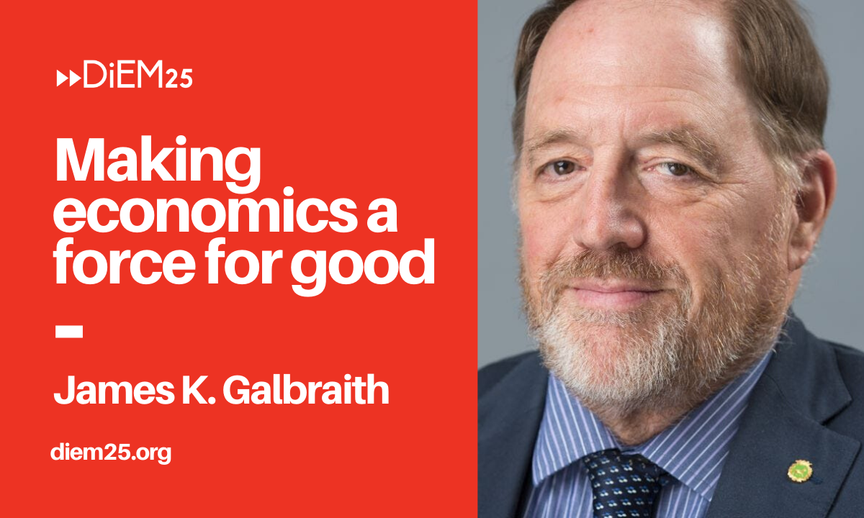
The State and Planning
“In a properly designed planning and markets do not contradict each other”.
“They are not mutually exclusive. Rather, the choice of one or another for any particular problem is a matter of what works best for the purpose at hand”.
“Planning, properly conceived, deals with the use of today’s resources to meet tomorrow’s needs. It specifically tackles issues markets cannot solve”.
“A country that does not have a public planning system simply turns that function over to a network of private enterprise—domestic or foreign—which then becomes the true seat of economic power. And that is why the struggle over planning is, and remains, such a sensitive issue: it is a struggle over power”.

Slide 13
How to do institutional analysis (1)
Best way to understand an society is to understand its institutions – their nature and evolution. Hence all social sciences (e.g. politics, sociology, law) very important.
Analysis starts with institutions, and then moves to individuals and their two-way interactions with institutions.
Institutions and individuals co-evolve

Slide 14
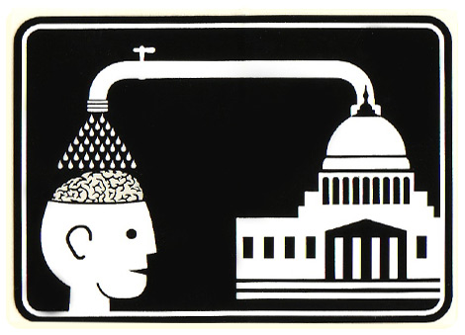
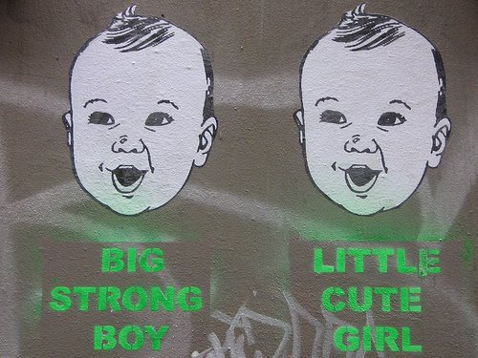
How to do institutional economics (2)
4. Concept of the institutionalised individual is the key to understanding individual behaviour.
5. Individuals are always formed by, and within, institutions. There is no such thing as an institution-free individual.
6. family, education, culture, advertising, media, etc all play a role

Slide 15
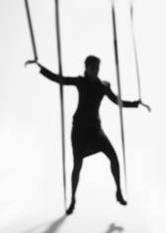
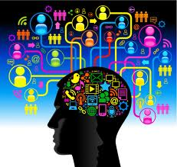
How to do institutional economics (3)
7. Institutions possess and exercise power over individuals and groups – this may be direct/coercive, or indirect/soft.
8. Learning is important but it to occurs within an institutional framework.
9. Individuals have no institution-free ways of acting.

Slide 16
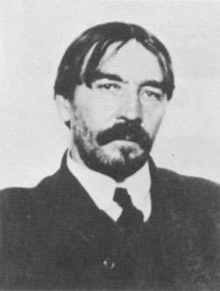
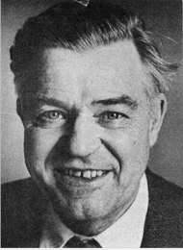
Foundational Institutionalists
Thorstein Veblen
Gunnar Myrdal
John Kenneth Galbraith

Slide 17
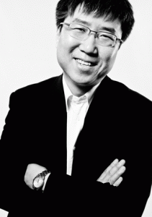
Prominent Contemporary Institutionalists
Ha Joon Chang
Anne Mayhew
Geoff Hodgson

Slide 18
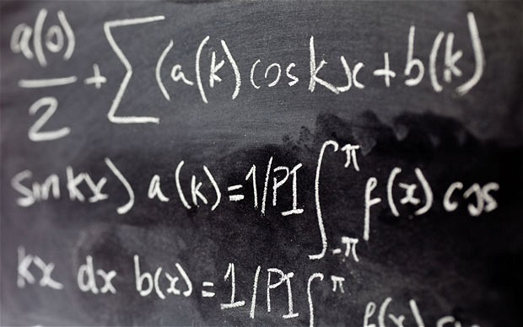
Methods of institutional analysis
Primarily qualitative (nature, functions, interactions, evolution of the institutions), and
Does still utilise quantitative information (for example ABS type statistics)
Set in specific historical, social, spatial circumstances
Contrast with other approaches which are quantitative, ahistorical, asocial, aspatial (as in physics).

Slide 19
Structure and Agency
Structure = existing institutions of society significantly determine much behaviour
Agency = our own choices and actions determine behaviour, and also institutional structure
Which is more important?
What is the relationship between the two types of causation?

Slide 20
Methodological Interactionism
In institutionalism (and reality?) structure and agency co-determine one another. As a consequence:
History becomes important
Context becomes important
To understand the present society, you need to know how it arrived at its current set of institutions.
Rejection of methodological individualism (where there is no downward causation from society to individual)
Rejection of methodological collectivism (where individuals actions and thoughts are totally determined by society)

Slide 21
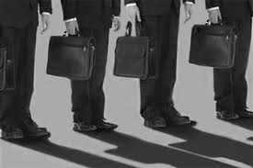
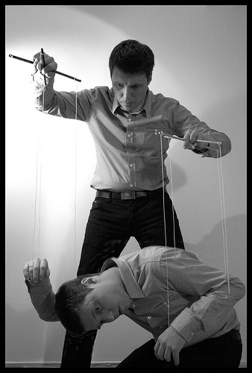
VALUES & INSTITUTIONS
Values are embedded in all institutions
But values of whom? – the powerful few, the many? Both?
Many of the values embedded in existing or proposed institutions are taken as normal (or invisible) until challenged and investigated
Always ask: who wins, who loses?
Examples: divine right of kings; forms of marriage; free trade agreements.

Slide 22
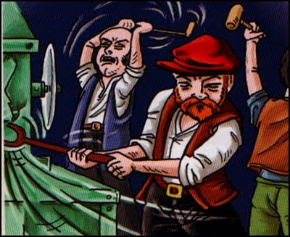
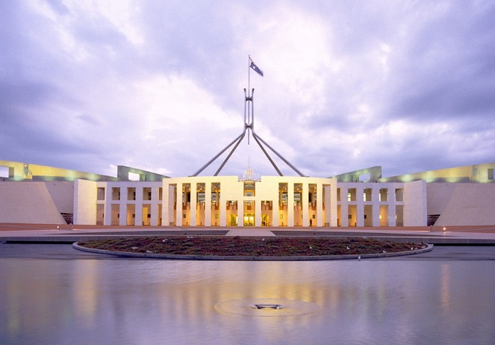
Technology and Institutions
Many institutions characterised by inertia.
Technological progress is dynamic
This creates tension that often leads to creation of new or modified institutions
Tension can be peaceful or conflictual, gradual or revolutionary
Q. how will the technology of renewable energy impact current institutions?
Q. How to current institutions impact on the technology of renewable energy?

Slide 23
Circular and Cumulative Causation (CCC)
Alternative framework to the equilibrium approach.
Assumes instability and increasing returns
Change, calls forward supporting changes in direction of the initial change.
Change in A prompts a change in B which then prompts an even larger disturbance to A and so on: increasing returns
Snowball rolling down a hill, gather in size and speed at an increasing rate .

Slide 24
Virtuous versus vicious circles
CCC can a virtuous circle (where desirable change feeds on itself)
Can be vicious circle (where undesirable change feeds on itself).
CCC has wide field of applicability: racism, third world poverty, regional disparities (see Stilwell for an excellent discussion on this)
Helps to explain ‘winner-take-all’ markets (Robert Frank).

Slide 25
CCC applied to economic growth
CCC relevant to economic growth.
Specifically, emergence of mass production and how it spreads throughout the system by forces of its own making.
Evolutionary – not static and mechanistic
Increasing returns, history important
Social variables interact with ‘economic’ variables.

Slide 26
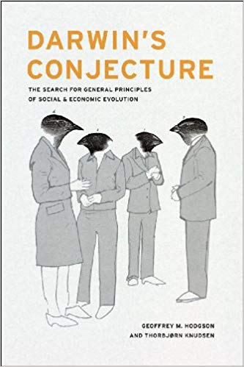
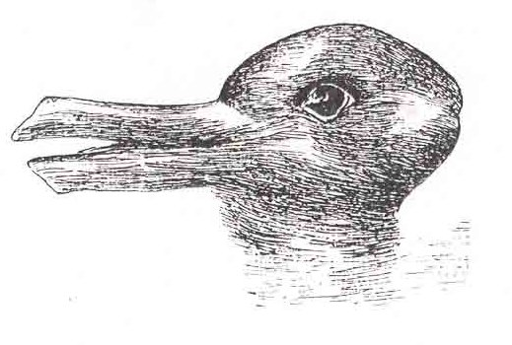
Evolution and institutions
Any school of thought needs some sort of theoretical engine – can’t ‘just do it’
Arguments is that Darwinian evolution supplies the theoretical framework to analyse institutions, habits, routines, etc.
Darwinian evolution = variety, retention, selection
Some institutionalists refer to themselves as evolutionary economists
Evolutionary framework can cope well with history, context, learning, adaptation.
Non-teleological

Slide 27
Notes on this Week’s Readings
Reading 1. Stretton on Institutionalism
Analysis of micro-credit, slightly dated, now a more contested policy, and alternative policies such as savings group (among others) my be superior in some cases.
Then Choose From Either
Argyrous on Circular and Cumulative Causation
Galbraith on the Need for Planning

Slide 28
Key points
Institutions are the formal and informal rules necessary for social and economic world to function.
Standard economics largely ignores institutions
A market is an institution that depends on other institutions to operate
Institutions shape what we do, but also who we are.
Methodological interactionism is central
Necessarily, largely utilises qualitative methods
Importance of history and context
Importance of power
Importance of the state regulation and planning.

Slide 29
References
Coase, R. H. (1984). "The New Institutional Economics." Journal of Institutional and Theoretical Economics 140(1): 229-231.
Steinmo, S. (2008). Historical Institutionalism Approaches and methodologies in the social sciences: a pluralist perspective. D. Della Porta and M. Keating. Cambridge, UK, Cambridge University Press: 118-138.
Underhill, G R D 1994, 'Conceptualizing the Changing Global Order', in G R D Underhill & R Stubbs (eds), Political Economy and the Changing Global Order, Macmillan, London.
Galbraith, James (2009) The Predator State: How Conservatives Abandoned the Free Market and Why Liberals Should Too. Simon and Shuster, New York.

