Slide 1
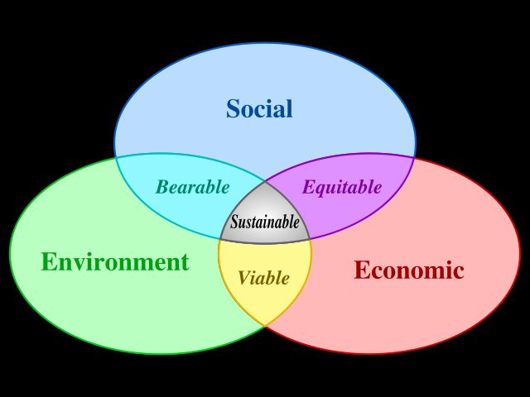
What does a Sustainable Economy Look Like?
Dr Tim Thornton, Director, School of Political Economy, Melbourne
Senior Research Fellow, Economics in Context Initiative, Global Policy Development Centre, Boston University

Slide 2
Introduction
Responding to the climate emergency necessarily involves economics and political economy
Economic arguments are often used to (essentially) argue ‘we can’t afford the future’!
Sustainable economy is a big and interesting area. There are of course some debates, and also some uncertainties, about what a sustainable economy looks like and how we might best transition towards it.
Given this, it’s important for everybody to evaluate the options for themselves and to be able to identify common ground as well as points of difference between positions.

Slide 3
Three (somewhat) different visions for a sustainable economy
Green Growth
Green New Deal
The Steady-State and De-Growth Economy

Slide 4
Some Caveats
Categories are a useful and defensible way to structure an otherwise initially bewildering examination, but remember:
They are simplifications
There is diversity within categories
There is overlap between categories
Particular policies and measures can sometimes be nested in any of these three categories.
Categorisation is often simplification: this can be both enabling and constraining
So, keep an eye out for synthesis and creative combination.
Points above also apply to dualisms such as capitalism versus socialism.

Slide 5
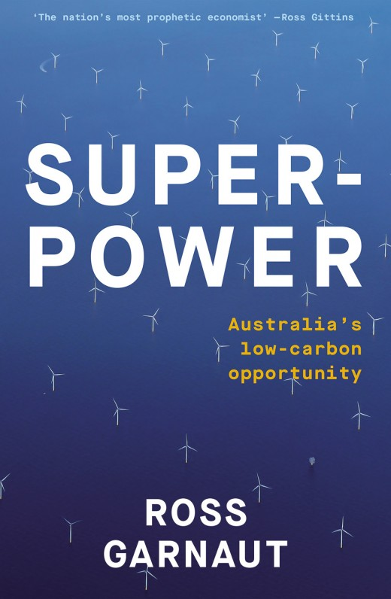
Green Growth (Some Examples)
Ross Garnaut (2020) Superpower: Australia’s Low Carbon Opportunity
OECD’s (2017) Investing in Climate, Investing in Growth

Slide 6
Core features
Technological progress and market signals and incentives delink economic growth and environmental damage.
Profit motive leads firms to use inputs more efficiently, and to minimise the waste production.
Firms respond to increasing consumer demand for greener products.
Usually supported by either pro-market, pro-business, regulation light orientation
Little or no emphasis on genuinely radical restructuring of the economy or society: distribution of wealth and power, consumption choices (i.e. consuming less stuff), general (intrinsic?) characteristics of a capitalist (market) society.

Slide 7
Some criticisms
Required rates of technological progress seen as unrealistic (based on current trajectories).
Evidence on ‘de-coupling’ of growth and environmental damage, thus far, varies between weak and non-existent
‘Rebound effect’ and ‘Backfire effect’ whereby efficiencies that drive cost reductions that simply enable increased levels of consumption.

Slide 8
Common Questions
Can problems created by growth be solved by more growth?
Can problems created by technological progress be solved by more technological progress?
Are we thinking in simplistic and over-aggregated dichotomies

Slide 9
Responses
We always have to ask:‘Growth (and De-Growth) of what?’
Solar panels versus coal mines, cars versus trams etc.
What sort of technology? Battery storage versus space tourism?
Developed by whom?
Controlled by whom?
Funded by whom?
Directed for the benefit of what and whom?
Technological over-optimists versus technological pessimists.
Technological progress is a complement rather than substitute for political, economic, social change.

Slide 10
Assessment of Green Growth
Not sufficient
A half-measure (at best)
However, it is nonetheless a start, and it may lay some of the groundwork and momentum for ambitious responses.
An easier see in countries that are the worst of the worst (e.g. Australia).
Reform versus revolution?
Pressure relief valves versus momentum building?
Need to make Australia less of a drag on global momentum as first step.
Being a global leader then becomes the next step to be taken asap. Next decade is increasingly seen as critical.

Slide 11
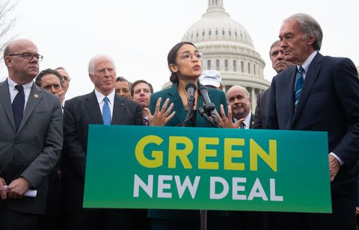
Green New Deal (GND)
Comes in different shades of green (or red?). Generic version as follows:
Potentially able to absorb much of the desirable features of Green Growth but goes much further
Pro economic growth, though the nature of that growth can be shaped.
GND compatible with Personal Carbon Trading/Total Carbon Rationing. Command (wartime) capitalism
Keynesian macroeconomics
Job guarantees, universal basic income, universal basic services.
GND welcomes and actively supports desirable technological progress, but as complement to full scale economic and social change.

Slide 12
Examples of Green New Deal
Sanders US Green New Deal (detailed and costed)
See ‘A message from the future’
Corbyn UK Green New Deal
European GND (Since late 2019) – 60% Emissions
China? (Since 3 days ago – 90% Reduction Net zero emissions 2060)
Other powerful countries likely to combine in punishing Australia
Is the Biden plan a GND or a Green Growth/GND hybrid?

Slide 13
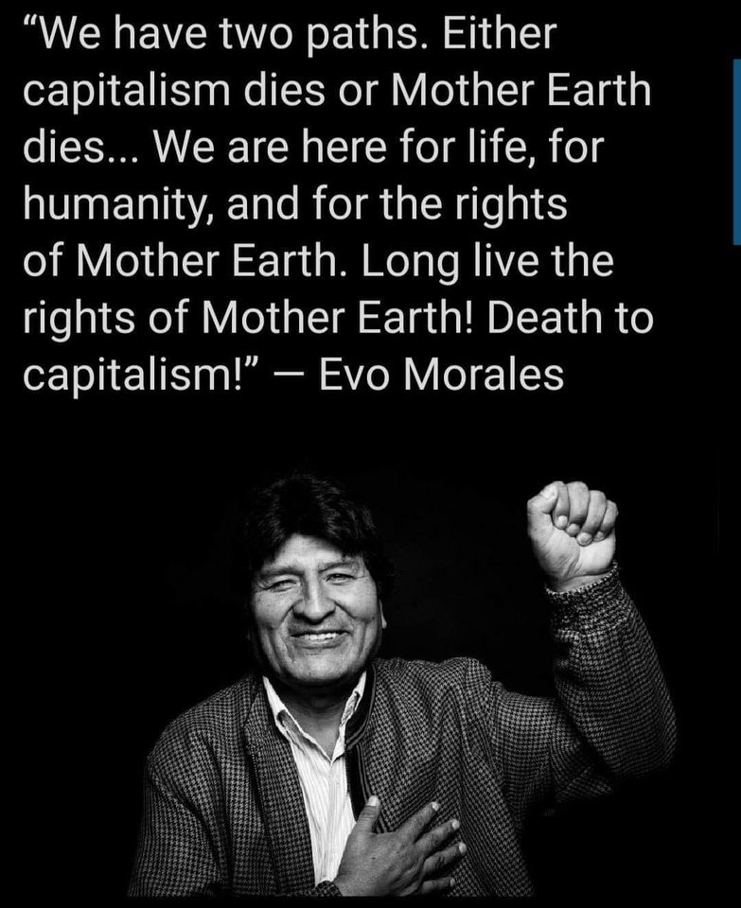
Eco-Socialist Critique of Capitalist Green New Deal
All forms of capitalism are intrinsically unsustainable. Why?
profit imperative > growth imperative = environmental damage.
corporate corruption of policy making
corporate corruption of the media and culture (ruling class, ruling culture)

Slide 14
Response
Problems of the capitalism-socialism as dichotomy
Diversity of both capitalism and socialism
Neoliberalism, Social Democracy, Market Socialism, Command Socialism, Intentional Communities
Differences between within > greater than differences between
Problems of socialism (and capitalism) in practice.
The issue of transition and timing
Socialism both beyond, and within Capitalism? (see Erik Olin-Wright)
United front between reformers for the immediate period?
Ration/quotas to box capitalism into ecological limits?

Slide 15
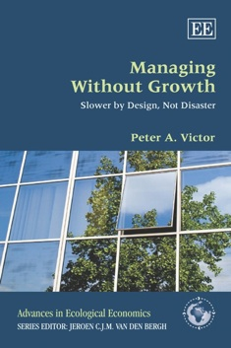
3. Steady State and De-Growth
Steady level (no-growth) or reduce it (de-growth).
Ending economic growth, at least measured via Gross Domestic Product (GDP)
Less goods and services = less material through put
Biosphere has real and hard limits.
Technology can only address this problem up to a point.
Both capitalist and socialist formulations of the steady state, de-growth economies

Slide 16
Steady-State/De-Growth Some Key Strands
Peter Victor and Tim Jackson ‘Prosperity Without Growth’ ‘Managing Without Growth’
Sam Alexander ‘Voluntary Simplicity’
Ted Trainer ‘Abandon Affluence’
Murray Bookchin
Sometimes draws on anarchist and permaculture literature
Top-down versus bottom up, versus state-enabled
Possibilities of creative synthesis/co-existence with GND?
Links to ideas around intentional communities such as Zapitistas and Rojava Communes

Slide 17
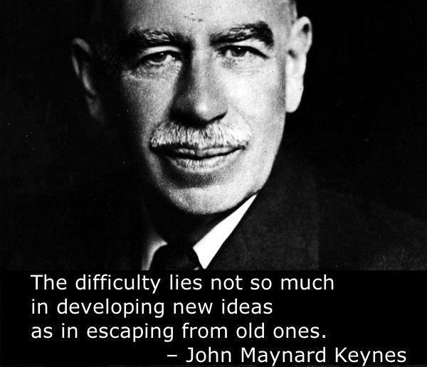
Assessment (1)
Environmental limits are real.
Why should we be so (seemingly) hard-wired to having to increase the amount of goods and services and population just to avoid economic crisis or stagnation?
Working less, consuming less, but having more leisure and concentrate on our own interests and connections with others is desirable to many, if not all people.
“When the accumulation of wealth is no longer of high social importance, there will be great changes in the code of morals. We shall be able to rid ourselves of many of the pseudo-moral principles which have hag-ridden us for 200 years, by which we have exalted some of the most distasteful of human qualities into the position of the highest virtues. We shall be able to afford to dare to assess the money-motive at its true value. The love of money as a possession -as distinguished from the love of money as a means to the enjoyments and realities of life -will be recognised for what it is, a somewhat disgusting morbidity, one of those semi-criminal, semi-pathological propensities which one hands over with a shudder to the specialists in mental disease. All kinds of social customs and economic practices, affecting the distribution of wealth and of economic rewards and penalties, which we now maintain at all costs, however distasteful and unjust they may be in themselves, because they are tremendously useful in promoting the accumulation of capital, we shall then be free, at last, to discard” (Keynes 1930)

Slide 18
Questions and Issues (1)
Is voluntary simplicity a niche response or is it the major (only) way forward?
The necessity of the state(s) to drive radical change?
How to penalise free riders?
Too utopian? At least as the dominant response?
Why not more (and better) top down and more bottom up?
Peter Victor versus Robert Pollin Debates

Slide 19
Transitions and Complementarities in Australia (a personal view)
Green New Deal - which in turn might sometimes need to be transitioned to via Green Growth.
Eventual transition to steady-state/de-growth economy – of a type that would likely confound the capitalist-socialist dualism.
Bottom up and top-down both required.

Slide 20
Where do the ideas come from?
Political economy versus Economics
Institutional economics
Post Keynesian economics
Ecological economics
Marxian economics
Feminist economics
Austrian economics
‘Fusion’ cooking with these ingredients to address contemporary challenges.

Slide 21
What particular thinkers/sources?
Elinor Ostrom (also extensions of Ostrom by David Sloan-Wilson – Improving group efficacy and ProSocial and also Derek Wall – Ostrom’s Rules for Radicals)
Erik Olin-Wright: Realizable Utopias
Alec Nove: Economics of Feasible Socialism
Anything by John Kenneth Galbraith
Hugh Stretton – Economics: A New Introduction (barefoot doctors manual for economics)
Duncan Green: How Change Happens

Slide 22
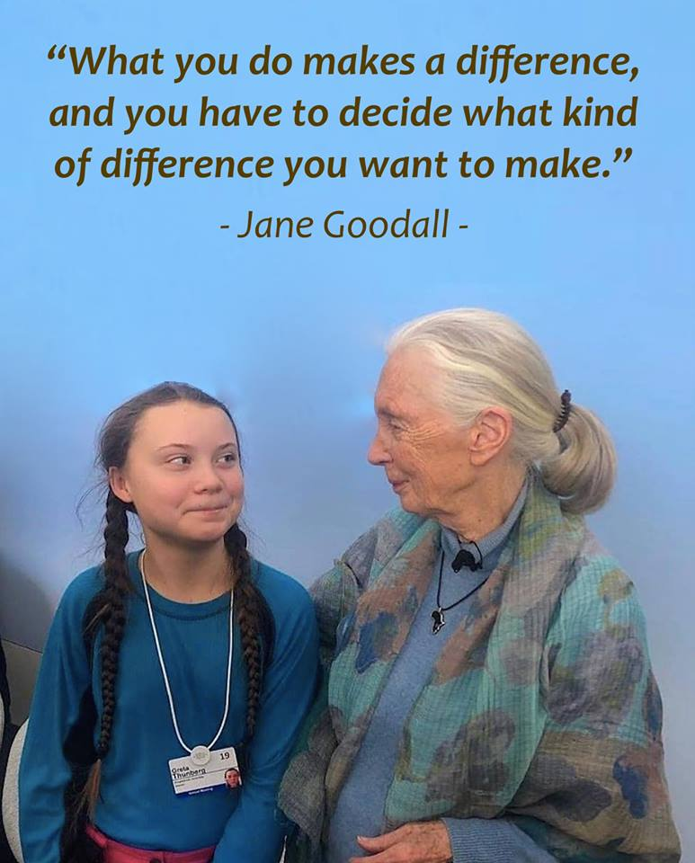
What is to be done?
The words of ancient oracle (a.k.a Greta Thundberg): “do everything you can, as often as you can with everybody that you can.”
Complexity, non-linearity, emergence remind us how just how quickly things can be changed (for the better as well as the worse)
Optimism versus pessimism versus opportunism
Optimism of the intellect and the will

Slide 23
Further information
Free Resources on Political Economy and Economics:
How Change Happens
Free Teaching Modules on Economics
Courses in Political Economy and Economics
Melbourne Sustainable Societies Institute

