Slide 1
Sustainable Development Goal 9
Jerry Courvisanos
Associate Professor of Innovation and Entrepreneurship
Federation University Australia
Tuesday 29 October 2019
RMIT Council Chamber

Slide 2
Key aspects of literature review

Slide 3
Notes:
Tell the story.
The majority of responses only focused on market research and promotion as being important.

Slide 4
Goal 9: Industry, Innovation and Infrastructure Build resilient infrastructure, promote inclusive and sustainable industrialisation and foster innovation

Slide 5
Focus on SDG9
Economy that is…
Resilient: infrastructure, regions, industry sectors
Inclusive: decent jobs for all, stakeholder commitment
Sustainable: three Ps (profit, people, planet)
Innovative: competitive, collaborative, transformative

Slide 6
Sustainable Development (SD)
“The essence of sustainable development is to provide for the fundamental needs of humankind in an equitable way without doing violence to the natural systems of life on earth.” (Kemp and Martens, 2007, p. 5)
SDGs: Path to SD is non-optimal and dynamic, with business ventures (& new programs) that embrace:
productive union of mind and nature
linking economic (profit), social (people) and ecological (planet) in business practice
support with local/regional/national community
Requires eco-innovation to SD path
Notes:
Tell the story.
The majority of responses only focused on market research and promotion as being important.

Slide 7
Fundamental Flaw or Oxymoron
Policy Brief SDG 3 Debbi Long: “fundamental flaw” of the SDGs between promotion of both economic growth and sustainability, esp. in SDGs 8 and 9
Self-contradiction to reveal a paradox of….
Advocating economic growth [EG] underpinned by an economic model that assumes optimal balance with infinite resources (neoclassical), and
Advocating SD underpinned by an economic model that assumes non-optimal and dynamic adaptation of development to address finite resources (circular)
Economic Model: EM-EG or EM-SD?

Slide 8
Target 9.1
Develop quality, reliable, sustainable and resilient infrastructure, including regional and transborder infrastructure, to support economic development and human well-being, with a focus on affordable and equitable access for all [EM: growth with social equity]
Indicator 9.1.1
Proportion of the rural population who live within 2 km of an all-season road [EM-EG]
Indicator 9.1.2
Passenger and freight volumes, by mode of transport [EM-EG]

Slide 9
Target 9.2
Promote inclusive and sustainable industrialization and, by 2030, significantly raise industry’s share of employment and gross domestic product, in line with national circumstances, and double its share in least developed countries
Indicator 9.2.1
Manufacturing value added as a proportion of GDP and per capita [EM-EG]
Indicator 9.2.2
Manufacturing value added as a proportion of GDP and per capita [EM-EG]

Slide 10
Target 9.3
Increase the access of small-scale industrial and other enterprises, in particular in developing countries, to financial services, including affordable credit, and their integration into value chains and markets
Indicator 9.3.1
Proportion of small-scale industries in total industry value added [EM-EG]
Indicator 9.3.2
Proportion of small-scale industries with a loan or line of credit [EM-EG]

Slide 11
Target 9.4
By 2030, upgrade infrastructure and retrofit industries to make them sustainable, with increased resource-use efficiency and greater adoption of clean and environmentally sound technologies and industrial processes, with all countries taking action in accordance with their respective capabilities
Indicator 9.4.1
CO₂ emission per unit of value added [EM-SD]

Slide 12
Target 9.5
Enhance scientific research, upgrade the technological capabilities of industrial sectors in all countries, in particular developing countries, including, by 2030, encouraging innovation and substantially increasing the number of research and development workers per 1 million people and public and private research and development spending
Indicator 9.5.1
Research and development expenditure as a proportion of GDP [EM-EG]
Indicator 9.5.2
Researchers (in full-time equivalent) per million inhabitants [EM-EG]

Slide 13
Target 9.A
Facilitate sustainable and resilient infrastructure development in developing countries through enhanced financial, technological and technical support to African countries, least developed countries, landlocked developing countries and small island developing States
Indicator 9.A.1
Total official international support (official development assistance plus other official flows) to infrastructure [EM-EG]

Slide 14
Target 9.B
Support domestic technology development, research and innovation in developing countries, including by ensuring a conducive policy environment for, inter alia, industrial diversification and value addition to commodities
Indicator 9.B.1
Proportion of medium and high-tech industry value added in total value added [EM-EG]

Slide 15
Target 9.C
Significantly increase access to information and communications technology and strive to provide universal and affordable access to the Internet in least developed countries by 2020
Indicator 9.C.1
Proportion of population covered by a mobile network, by technology [EM-EG]

Slide 16
Clash of Frameworks
EM-EG framework: Priority to economic growth measured by GDP and ancillary indicators as set out in 7 out of 8 targets, with “weak sustainability” where technological innovation and scarce resource pricing resolves dilemma
EM-SD framework: Priority to “development” of economy (regional and national) as identified by ecological and social indicators – CO₂ emissions, pollution rates, social access – where ecosystem biodiversity and social wellbeing underpin progress (only one SDG9 target)

Slide 17
EM-SD Frameworks
Genuine progress indicator (GPI) and Index of Sustainable Economic Welfare (ISEW) are metrics of this framework; not mentioned in the SDGs
GPI has a more social well-being orientation than ISEW
Both aim to calculate the ecological and social costs (or negatives) of economic activity, along with the standard economic positives.
Modelling the economy is divided in two approaches:
Degrowth (Steady-State) – see Victor (2008)
Green growth (Green New Deal) – see Pollin (2015)
Notes:
GPI adds crime, divorce, unemployment and changes in leisure time to ISEW.
Green New Deal: argues for the greening of the existing economy: assuming continued economic growth, but reshaping the global economy to reduce greenhouse gas emissions by investing in energy efficiency and clean, low-emissions renewable energy sources.
Degrowth: argues that continued economic growth is incompatible with the biophysical limits of the earth, and that we need to move towards a steady state economy.

Slide 18
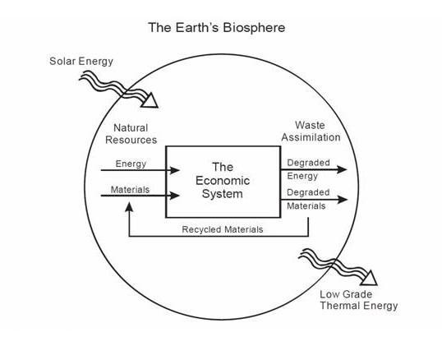
The Economic System and the Ecosystem
The economic system viewed as a closed circular subsystem of the global environment, with only energy entering and exiting from world’s ecology

Slide 19
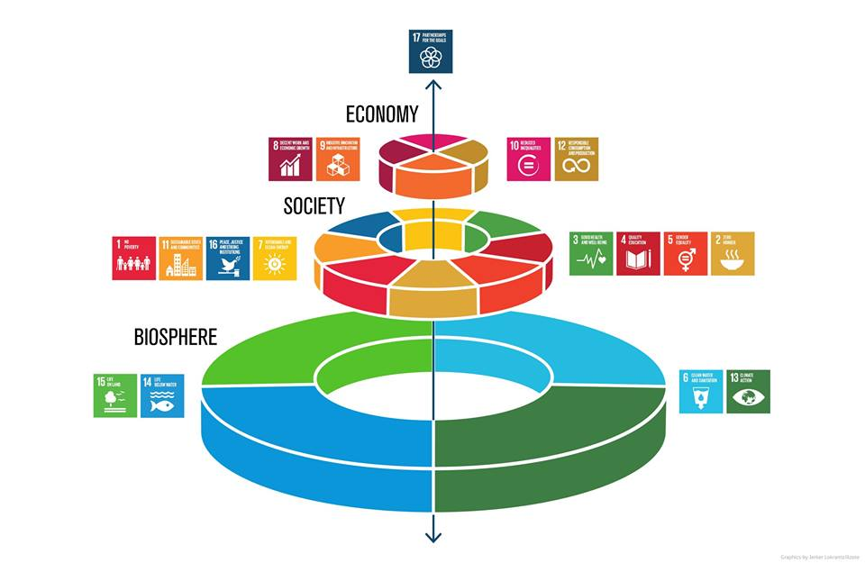

Slide 20
EM-SD Frameworks: Where?
Despite academic research work from as early as the 1970s: Meadows et al. (1972), Schumacher (1973) and Daly (1977), and more recent…
Policy and political interventions post-GFC: A Green New Deal (UK 2008), Pact for a Green New Deal (New Deal vert au Canada 2019), US Congress resolutions led by Rep. Alexandria Ocasio-Cortez (2019), Statistics Finland data on GPI 1945-2011
Still not mainstream enough to be in the UN-SDGs
Why not mainstream?

Slide 21
EM-SD Frameworks: Why not?
External issues:
Structural change hits the weaker “rust/mining belts” and their workers have limited mobility and reskilling abilities
Works against middle-class aspirations
Internal issues:
Debates on alternative development indexes and alternative models
Quantity versus quality (what is incommensurable?)
Capitalism versus anti-capitalism approaches to green

Slide 22
Global Progress of SDG9 in 2019
International maritime freight 3.7% in 2017, but projected growth will test capacity of infrastructure [Is such freight growth sustainable?]
Manufacturing slowed in both developing & developed regions, difficult to achieve target of doubling manuf. share of GDP by 2030 [Huge increase sustainable?]
Manuf employment :15.3% (2000) to 14.2% (2018)
Manuf by >20%, 2000-16; to 0.30 kg CO₂ per US$ [Decoupling CO₂ emissions and GDP growth]
R&D of GDP from 1.52% to 1.68% 2000-16 [EU and US 2.21%, developing countries well short of average]

Slide 23
Global Progress of SDG9 in 2019
R&D researchers per million inhabitants from 804 in 2000 to 1,163 in 2016, only 91 in sub-Saharan Africa
Economic infrastructure in developing countries 32.5% in real terms since 2010; main sectors assisted bank & finance ($13.4b.) and transport ($21.6b.) [59b. total]
Medium-high and high-tech sectors - 44.7% of global manufacturing value added (mostly in EU & US); 14.4% in least developed countries
90% of all people live within range of a 3G-quality or higher network [Network more rapidly than % of population using the Internet]
Source: United Nations (2019)

Slide 24
Australia and SDG9 in 2019
Resilient (ability of region to adapt to and shocks):
Limited by lack of diversity in industrial structure, depend on industries with low value commodity exports and limited indigenous innovation
Core metro with diverse activities demonstrating most resilience, yet no region with strong resilience throughout study period 1986-2011, and narrowing of industry base…lack infrastructure (now play ‘catch-up’)
Manufacturing declining, wages growth very low (2.3%)
Mining & education commodity low-value added exports
Financial services (regional centres), tourism (rural) need strategic policy focus
Source: Cutler (2008), Courvisanos et al. (2016), Mardaneh et al. (2019)

Slide 25
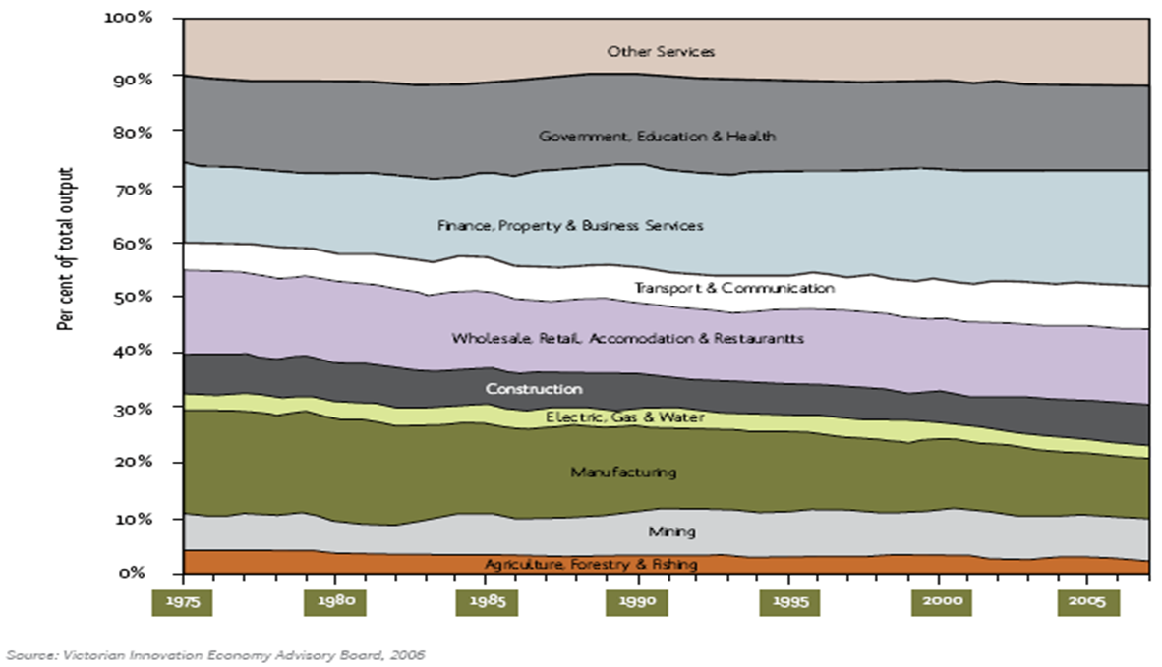
Sectoral Composition of Australia’s Output 1975 to 2007

Slide 26
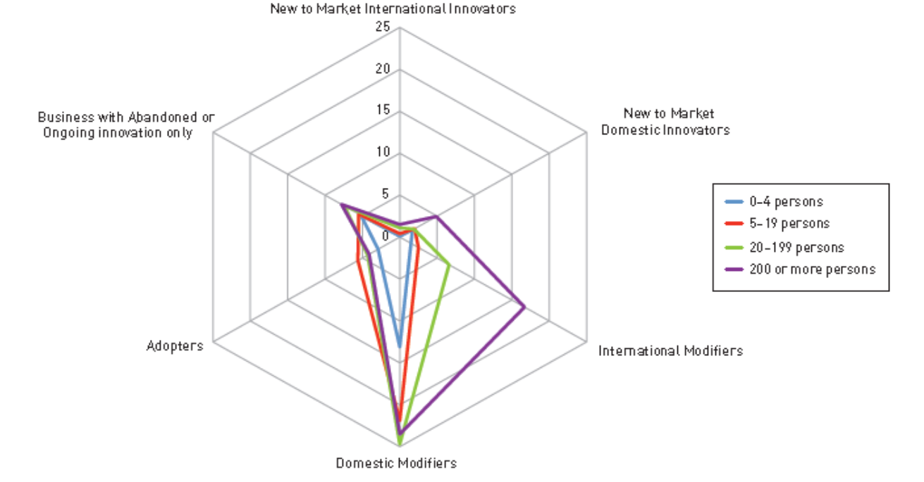
Source: Global Innovation Index (2014)

Slide 27
Australia and SDG9 in 2019
Inclusive (access decent life to all):
Large differences socio-economic well-being across divides – limits stakeholder commitment:
Rural/regional/periphery/metro (Resilience studies) e.g. federal election 2019
Income/gender/age – aspirational failings
Race/ethnic inequity – “[Not]Closing the Gap”/refugees
Social inequality: 5.66 between rich & poor
Rank: 21/39 OECD country “Better Life Index”, yet Melbourne 2nd and Sydney 3rd in “Liveability” Index” of all major cities in the world
Sources: OECD (2018), The Economist Intelligence Unit (2019)

Slide 28
Australia and SDG9 in 2019
Sustainable (no violence to natural systems):
Limited investment and infrastructure in renewable energy in both stationary and transport sectors
One of the worst countries for climate pollution per person and no national climate policy + recycling crisis, despite ‘meeting’ Paris CO₂ target
No long-term CO₂ target or strategic plan
Australia has been ranked 55th – ahead of only Chinese Taipei, South Korea, Iran, the USA and Saudi Arabia – in the latest Climate Change Performance Index
Source: Burck et al. (2018)
Notes:
The Government has stated it intends to “carry over” surplus emission units from the Kyoto Protocol towards its Paris Agreement target. This would significantly lower the actual emission reductions.

Slide 29
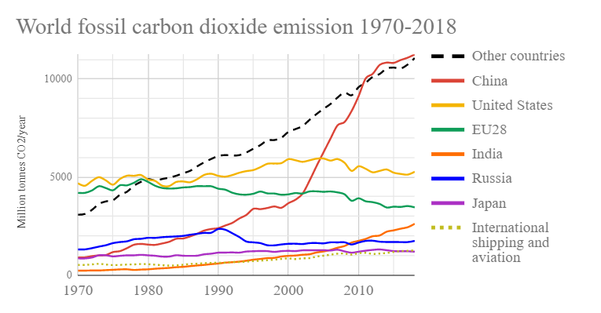

Slide 30
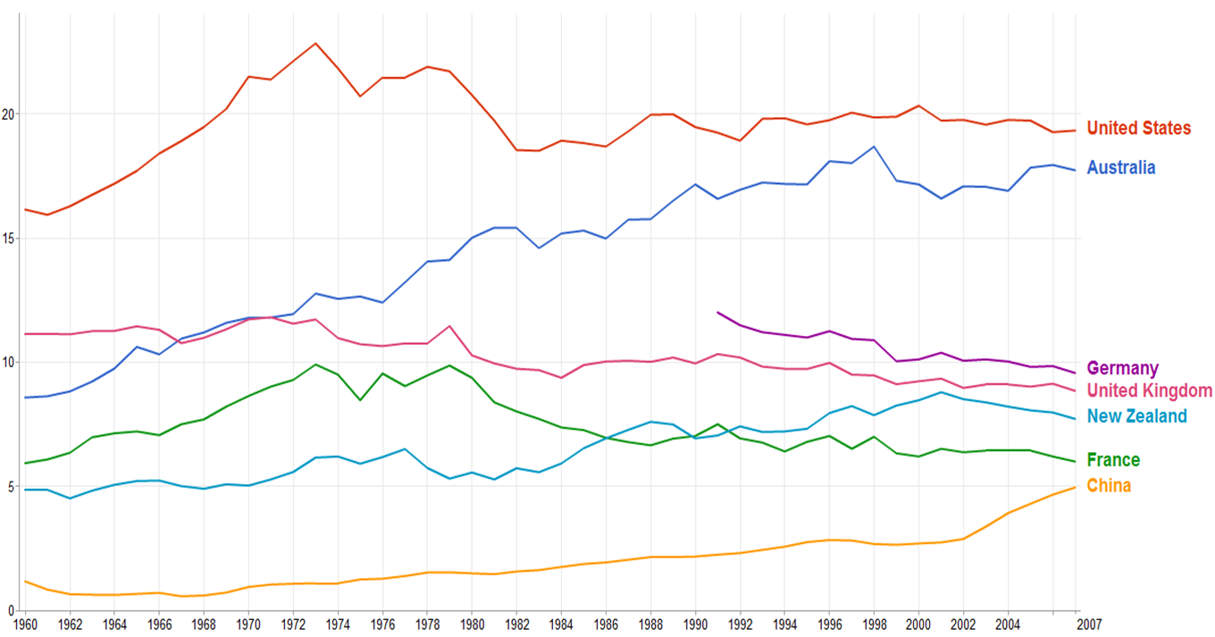
CO₂ Emissions Per Capita

Slide 31
CO₂ Emissions Per Capita
Office of the European Union, 2017 & 2018 2016 ranking by per capita emissions | Country | 2016 total carbon dioxide emissions from fuel combustion (million metric tons) | 2016 per capita carbon dioxide emissions from fuel combustion (metric tons) | 2017 per capita carbon dioxide emissions from fuel combustion (metric tons)
1 | Saudi Arabia | 527.2 | 16.3 | 19.4
2 | Australia | 392.4 | 16.2 | 16.5
3 | United States | 4833.1 | 15.0 | 15.7
4 | Canada | 540.8 | 14.9 | 16.9
5 | South Korea | 589.2 | 11.6 | 13.2
6 | Russian Federation | 1438.6 | 9.9 | 12.3
7 | Japan | 1147.1 | 9.0 | 10.4
8 | Germany | 731.6 | 8.9 | 9.7
9 | Poland | 293.1 | 7.7 | 8.4
10 | South Africa | 414.4 | 7.4 | 8.2
11 | Iran | 563.4 | 7.1 | 8.3
12 | China | 9056.8 | 6.4 | 7.7
Notes:
Note the worst. The highest emitters are very small countries/territories in 2017: Palau 64.9, Curaçao 46.8 (160,000 pop,n), Qatar 37.1, Trinidad and Tobago 27.6, Bahrain 24.0, Kuwait 23.5,

Slide 32
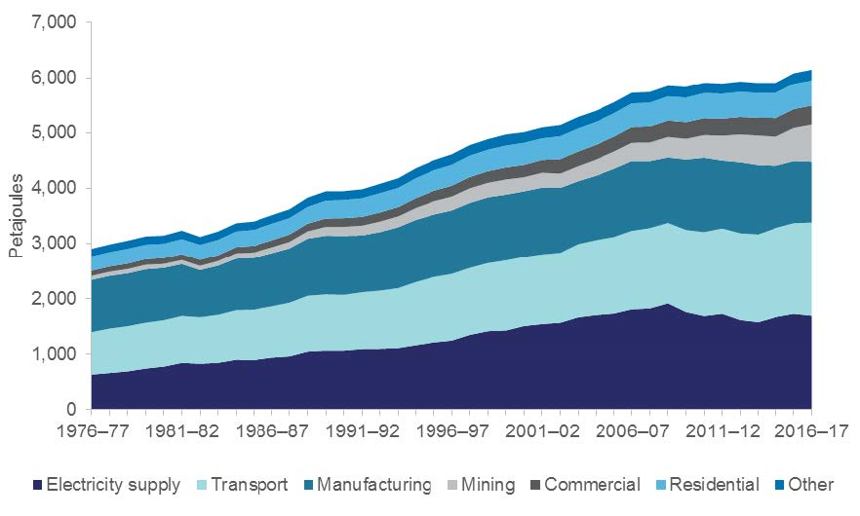
Australian energy consumption, by sector
Source: Department of the Environment and Energy (2018, p. 11)

Slide 33
Australia and SDG9 in 2019
Innovative (transformative eco-innovation):
“What is going to drive Australian prosperity in the years ahead? How does our economy transition? Our innovation agenda is going to help create the modern, dynamic 21st Century economy Australia needs.” (Turnbull, 2015)
SDGs Voluntary National Review: We are “innovators”
Transformative innovation is anti-cyclical and resilient (Fillppetti and Archibugi, 2011, Laperche et al., 2011)
Lack SD transformational shift with business investment weak; mining investment contracting since 2012 - “expected to grow in 2019” (Treasury Secretary, 23 Oct 2019)

Slide 34
Australia and SDG9 in 2019
“Australians are innovators. We have a highly-educated, vibrant and engaged population, shaped by world-class institutions. We have skills, experience and knowledge that can help deliver on the SDGs and have built partnerships across sectors and borders to address them. We have contributed our expertise to the development of the SDG Indicators and are sharing technology to help others develop the data to track and report.” SDGs Voluntary National Review, Australia (DFAT, 2018)
Highly limited SDGs action. Where is collaboration?

Slide 35
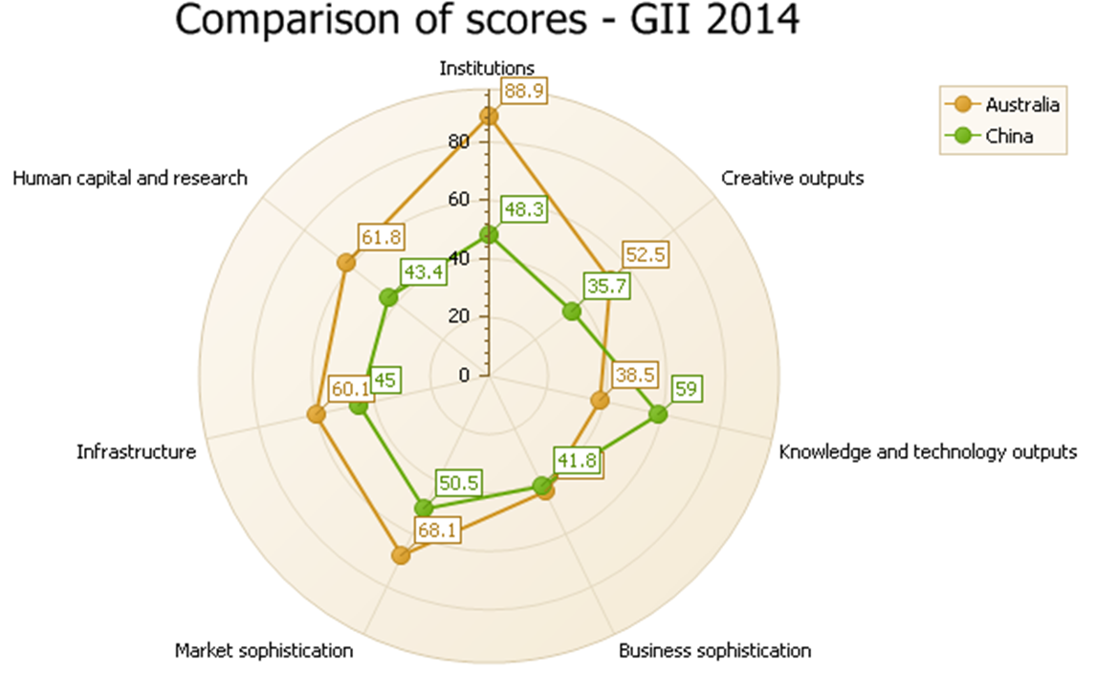
Source: Global Innovation Index (2014)
Notes:
Tell the story.
The majority of responses only focused on market research and promotion as being important.

Slide 36
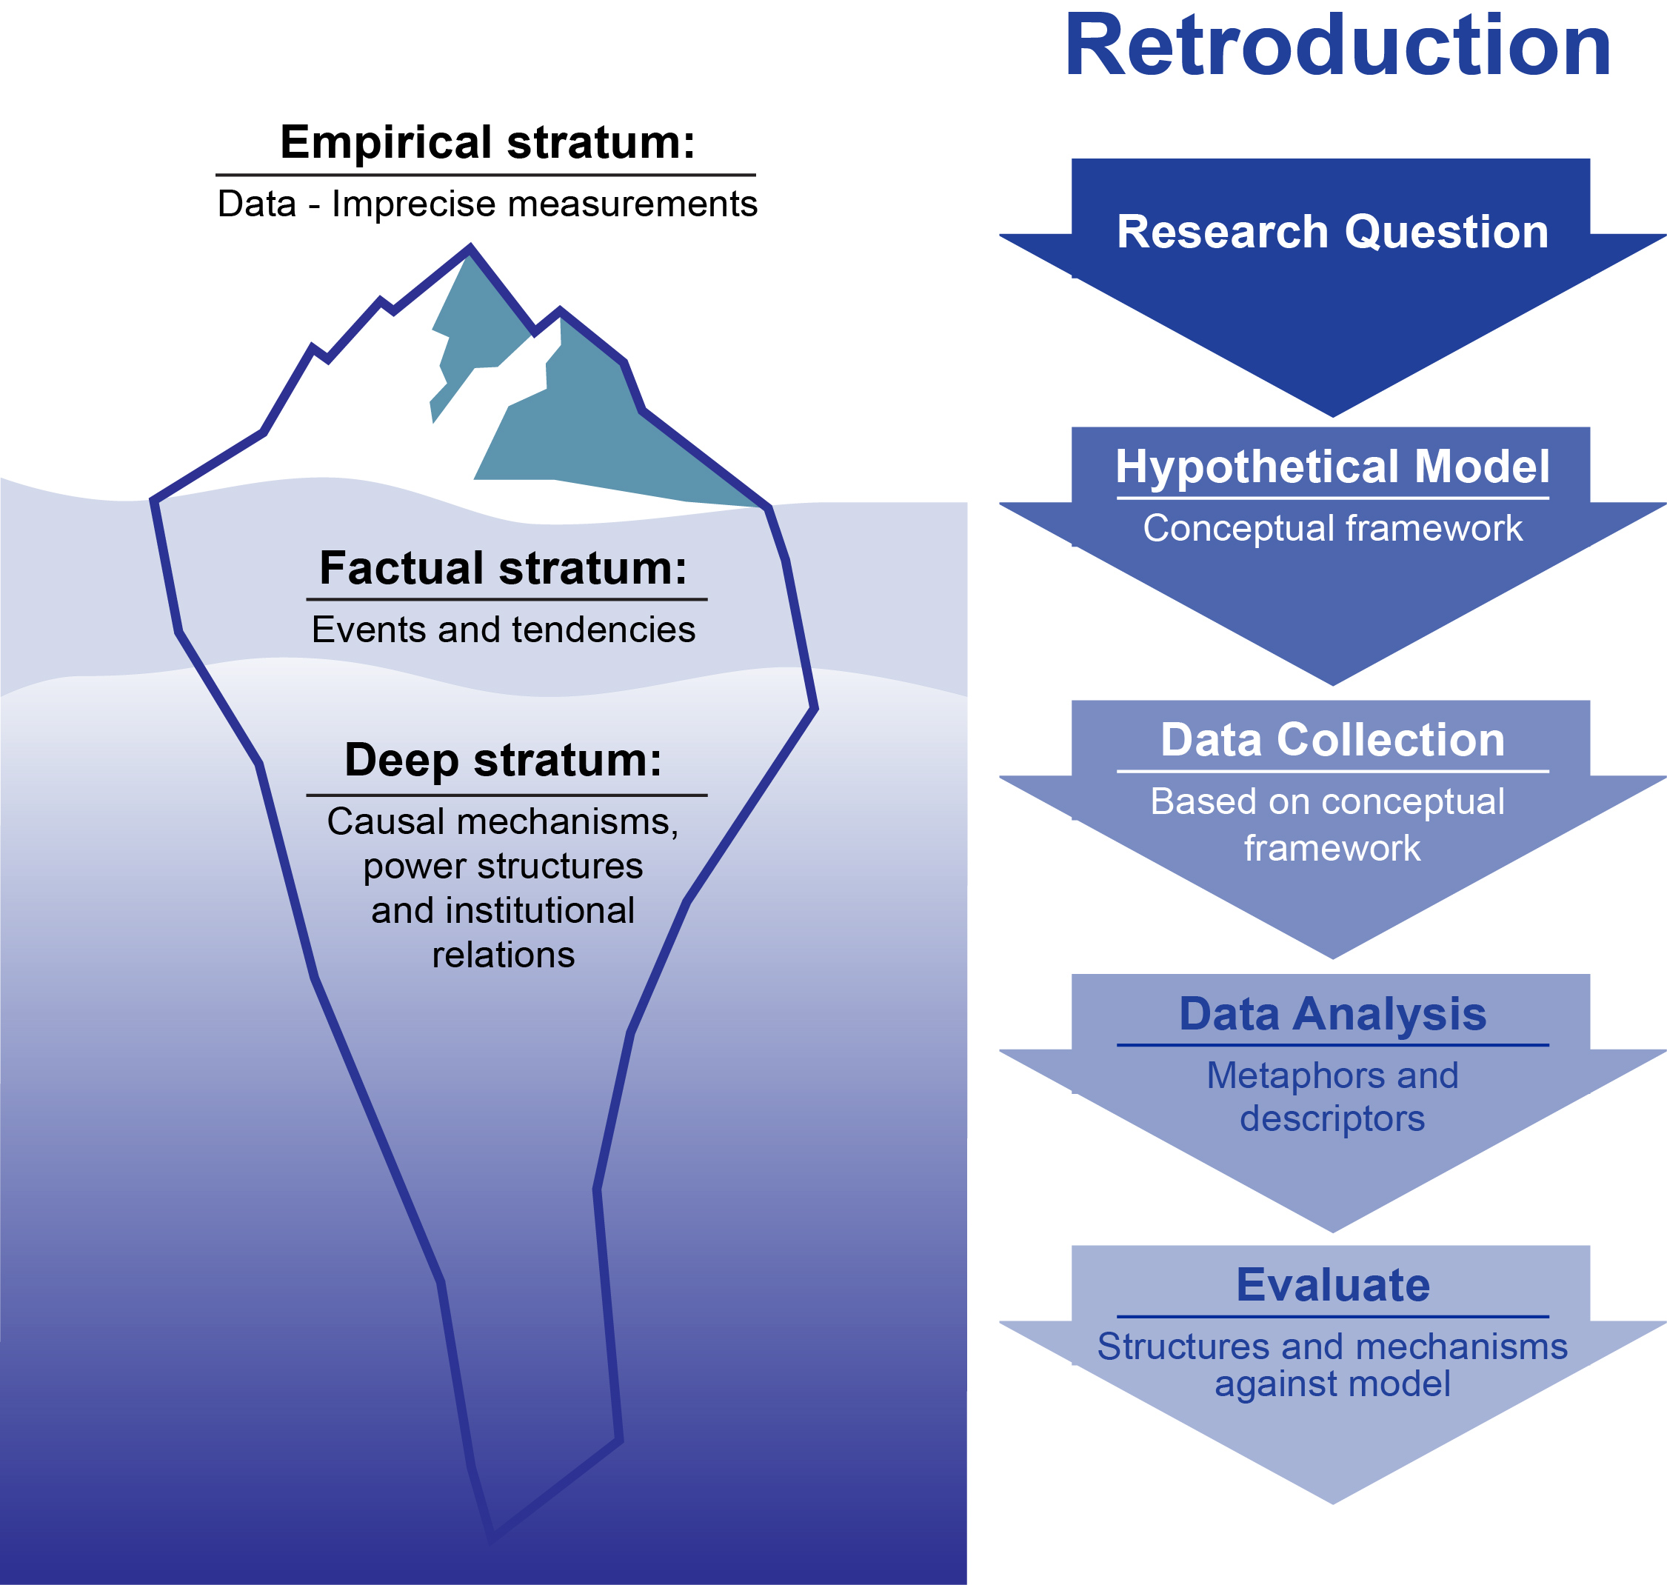
The three strata of reality

Slide 37
What is to be done?
Can not continue on the same development path with fine-tuning using standard EM-EG neoclassical economics tools (interest rates, tax cuts, infrastructure spending, micro-economic reform)
Need alternative EM-SD based on circular economy model that resolves internal debate
Focus on “eco-sustainable innovation” model underpin by Habermas Conceptual framework
(see Courvisanos, 2005; 2012)

Slide 38
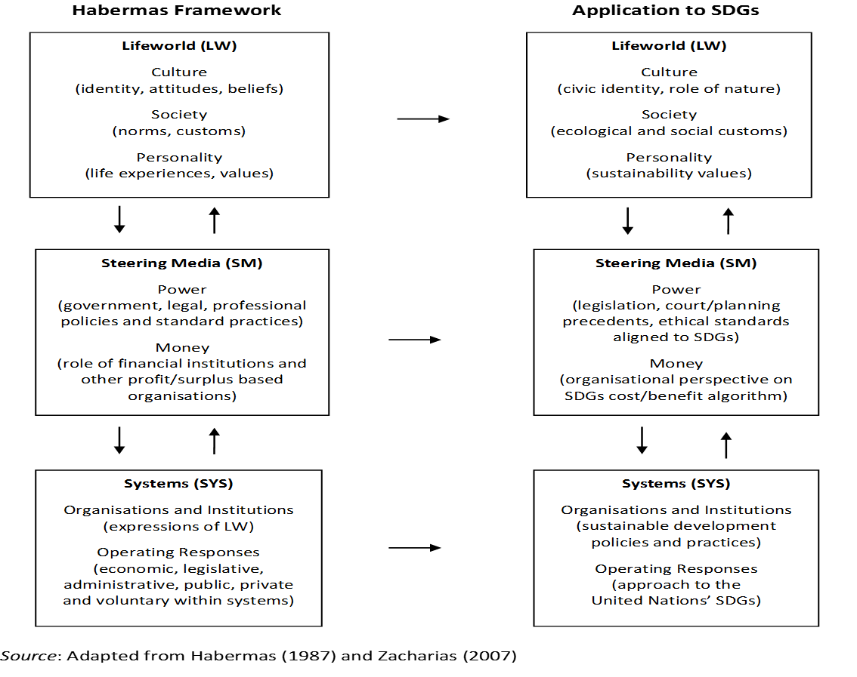
The conceptual framework

Slide 39
References
Burck, J., Hagen, U., Marten, F., Höhne, N., Bals, C. (2018), The Climate Change Performance Index: Results 2019. Germanwatch, Bonn. Accessed from https://www.climate-change-performance-index.org/sites/default/files/documents/ ccpi2019_results.pdf
Courvisanos, J. (2005), A Post-Keynesian Innovation Policy for Sustainable Development, International Journal of Environment, Workplace and Employment, 1 (2), 187-202.
Courvisanos, J. (2012), Cycles, Crises and Innovation: Path to Sustainable Development – A Kaleckian-Schumpeterian Synthesis. Cheltenham, UK and Northampton, MA: Edward Elgar.
Courvisanos J, Jain A and Mardaneh K (2016), Economic Resilience of Regions under Crises: A Study of the Australian Economy. Regional Studies, 50 (4): 629–643.
Cutler, T. (Chair) (2008), Venturous Australia: Building Strength in Innovation, Report on the Review of the Australian National Innovation System, Melbourne: Cutler & Company Pty. Ltd.
Daly, H. (1977), Steady-State Economics, San Francisco, CA: W. H. Freeman.
Department of the Environment and Energy (2018), Australian Energy Update 2018, August 2018 . Accessed from https://www.energy.gov.au/sites/default/files/australian_energy_update_2018.pdf
DFAT (2018), SDGs Voluntary National Review, Australia (DFAT, 2018)
Fillppetti, A. and Archibugi, D. (2011), Innovation in Time of Crisis: National Systems of Innovation, Structure and Demand, Research Policy, 40 (2), 179-92.
Global Innovation Index (2014). Accessed from http://www.globalinnovationindex.org/content.aspx?page=interactive-radar-chart
Habermas, J. (1987), The Theory of Communicative Action, Volume Two – Lifeworld and System, A Critique of Functionalist Reason (transl. from German by Thomas McCarthy), Boston: Beacon Press.
Kemp, R. and Martens, P. (2007), Sustainable Development, Sustainability, 3 (2), 5-14.

Slide 40
References
Laperche, B., Lefebvre, G. and Langlet, D. (2011), Innovation Strategies of Industrial Groups in the Global Crisis: Rationalisation and New Paths, Technological Forecasting & Social Change, 78 (8), 1319-1331.
Mardaneh K., Jain A and Courvisanos J. (2016), Regional Economic Resilience and Adaptive Cycle Patterns: Specialisation and Diversity in Australia, 1986 to 2011, submitted in September 2019 to Environment and Planning A: Economy and Space. Manuscript ID is EPA-2019-0338.
Meadows, D.H., D.L. Meadows, J. Randers and W. Behrens III (1972), The Limits to Growth, New York: Universe Books.
OECD (2018), OECD Better Life Index, 1 November 2017. Accessed from http://www.oecdbetterlifeindex.org/countries/ australia
Office of the European Union (2018 and 2019), Fossil CO2 Emissions of all World Countries: 2017 and 2018 Reports, Accessed from https://ec.europa.eu/jrc/en/publication/fossil-co2-emissions-all-world-countries-2018-report
Pollin, Robert. 2015. Greening the Global Economy. Cambridge, MA: MIT Press.
Schumacher, E.F. (1974), Small is Beautiful: A Study of Economics as if People Mattered, London: Abacus/Sphere Books (original published 1973 by Blond & Briggs).
The Economist Intelligence Unit (2019), 2019 Global Liveability Report , The Economist’ London.
Turnbull, M. (2015), Launch of the National Innovation and Science Agenda, 7 December.
United Nations (2019), Report of the Secretary-General, Special edition: Progress towards the Sustainable Development Goals. Accessed from https://undocs.org/E/2019/68
Victor, P. (2008), Managing without Growth: Slower by Design, Not Disaster. Cheltenham: Edward Elgar.
Zacharias, N. (2007), Work/life Balance through a Critical ‘Gender Lens’: A Cross-country Comparison of Parental Leave Provisions and Take-up in Australia and Sweden, PhD thesis, University of Ballarat, Australia.

Slide 41
Any Questions?

