Slide 1
Green New Deal :
Considerations for a
Foundations and Narratives
Belyan Matthews
President, PPE Society LaTrobe
19338569@students.latrobe.edu.au

Slide 2
OVERVIEW:
1. The case for a Green New Deal:
Not only an economic but also a social, political and cultural project.
2. Exploring the original New Deal implemented in 1930’s America.
3. The necessity of incorporating better measures of economic and social progress.
4. The need to discard
various beliefs, mindsets and narratives that hold back the pursuit of a Green New Deal.

Slide 3
“The idea is a simple one: In the process of transforming the infrastructure of our societies at the speed and scale that scientists have called for, humanity has a once-in-a-century chance to fix an economic model that is failing the majority of people on multiple fronts.”
- Naomi Klein
On Fire: the (burning) case for a Green New Deal p.26

Slide 5
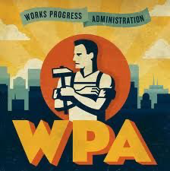
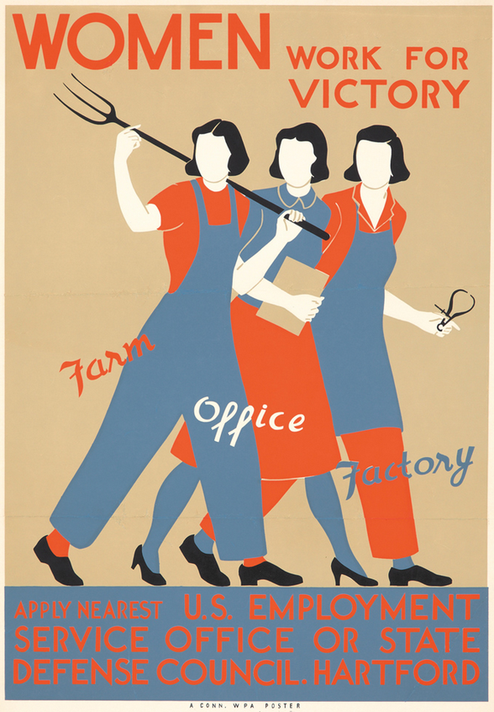
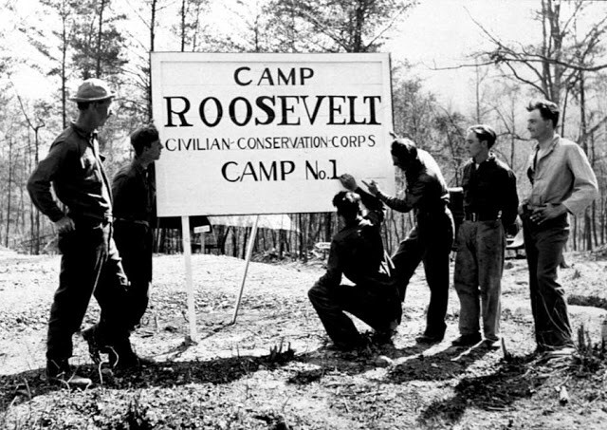
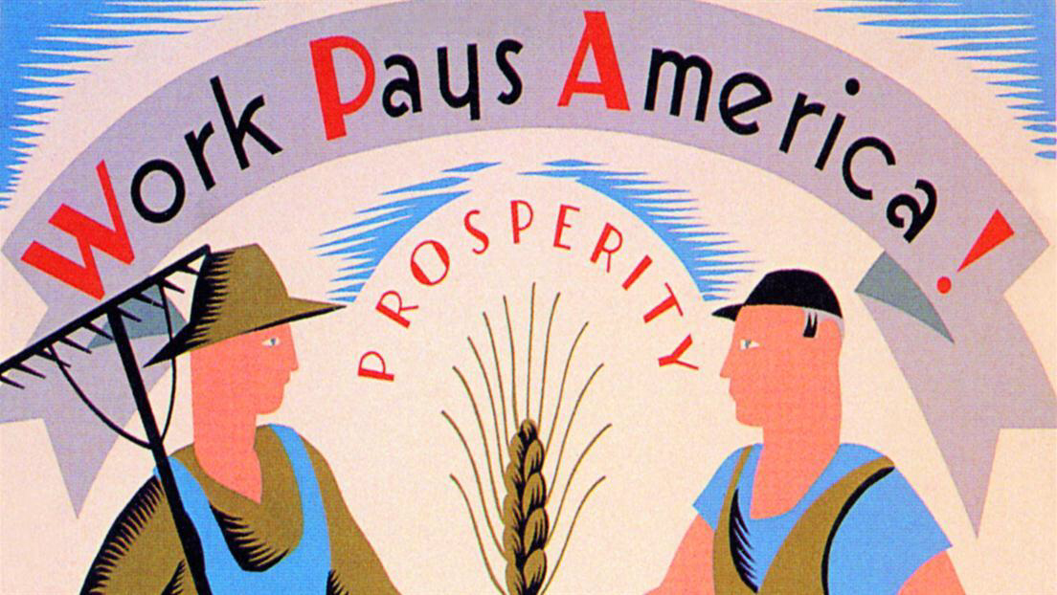
HISTORICAl CONTEXT: THE ORIGINAL NEW DEAL

Slide 6
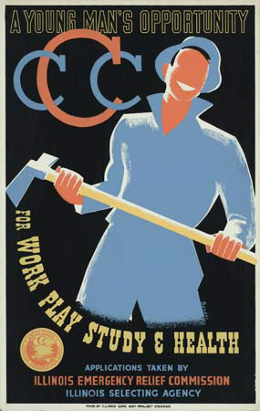
THE THREE Rs
Relief for farmers, the poor and unemployed -welfare expansion and federal jobs programs
Recovery of the economy (and ecology) -economic stimulus and land regeneration
Reform of banks and financial institutions -response to 1929 crash

Slide 7
From the ORIGINAL NEW DEAL to the GREEN NEW DEAL:
POINTS OF DIVERGENCE and GDP

Slide 8
GREEN NEW DEAL REQUIRES BETTER MEASURES of ECONOMIC and SOCIAL PROGRESS
GDP as a blunt instrument
The need for contraction and growth
Alternative measurements of success

Slide 9
REFLECTING ON RELATIONSHIP TO PLACE
and the process of
TRUTH-TELLING

Slide 10
“The stories we tell about who we are as a nation, the values that define us, are not fixed. They change as facts change. They change as the balance of power in society changes. Which is why regular people, not just governments, need to be active participants in this process of retelling and reimagining our collective stories, symbols, and histories… When the narratives and mythologies … no longer serve us, when they stand in the way of where we need to go, then we need to be willing to let them rest and tell some different stories.”
On Fire: the (burning) case for a Green New Deal pp. 173-174

